Slide 1
A Culture Shift: Moving Beyond Compliance into Full Membership In Higher Education
Enjie Hall
Hall.1270@osu.edu
(614) 292-3307
The Ohio State University

Slide 2
Access as a Civil Right
Civil Rights Act of 1964, Title II
“All persons shall be entitled to the full and equal enjoyment of the goods, services, facilities, and privileges, advantages, and accommodations of any place of public accommodation, as defined in this section, without discrimination or segregation on the ground of race, color, religion, or national origin.”
Americans with Disabilities Act of 1990

Slide 3
Legal Mandates
Americans with Disabilities Act:
Prohibits discrimination based on disability status
Individuals with disabilities must have access to reasonable accommodations
Section 504 of the Rehabilitation Act:
No individual shall be excluded from participation in a program or activity due to the presence of a disability

Slide 4
Data/Demographics
One in five people have a physical or invisible disability in the United States.
At OSU, only 20% of students with disabilities self-disclose and register for accommodations with Disability Services.
According to research done by Disability Services:
Students who register in their first year at OSU, as compared to those who wait, are more likely to graduate within six years.
Students with disabilities who also identify with another minority group are twice as likely to succeed in college.

Slide 5
Data/Demographics (continued)
Of people age 16 and older in the US:
21% with a disability are below the poverty level.
11% without a disability are below the poverty level.
72% with a disability are not in the labor force.
27% without a disability are not in the labor force.
(Disabled World July 26,2011, supplied by the US Censes Bureau 2011)

Slide 6
Inclusion in Diversity Statements
“Wright State University promotes the acceptance and appreciation of every individual regardless of race, gender, age, ethnicity, ability or disability, sexual orientation, socioeconomic status, religious affiliation, or national origin. We encourage appropriate activities and events that foster learning about the diversity of our world.”
To view entire statement, visit http://www.wright.edu/foundational-principles/diversity-statement

Slide 7
Inclusion in Diversity Statements
“The diversity of the people of California has been the source of innovative ideas and creative accomplishments throughout the state’s history into the present. Diversity – a defining feature of California’s past, present, and future – refers to the variety of personal experiences, values, and worldviews that arise from differences of culture and circumstance. Such differences include race, ethnicity, gender, age, religion, language, abilities/disabilities, sexual orientation, gender identity, socioeconomic status, and geographic region, and more.
Because the core mission of the University of California is to serve the interests of the State of California, it must seek to achieve diversity among its student bodies and among its employees. The State of California has a compelling interest in making sure that people from all backgrounds perceive that access to the University is possible for talented students, staff, and faculty from all groups. The knowledge that the University of California is open to qualified students from all groups, and thus serves all parts of the community equitably, helps sustain the social fabric of the State.”
To view entire statement, visit http://regents.universityofcalifornia.edu/governance/policies/4400.html

Slide 8
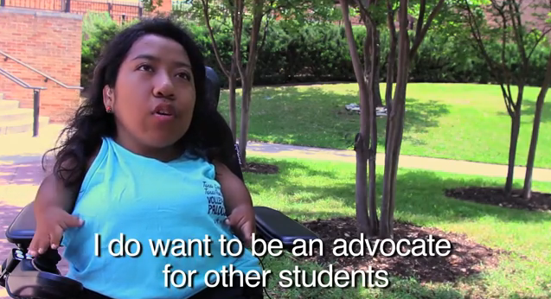
Student Disability Identity
Video

Slide 9
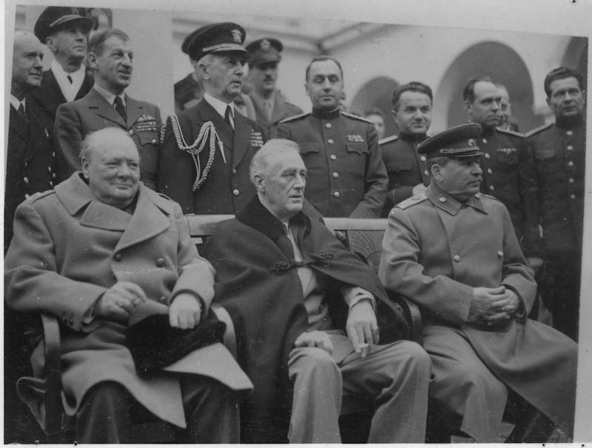
Winston Churchill, Franklin D. Roosevelt and Joseph Stalin at the Yalta Conference. Livadia Palace, Yalta, USSR. February 9, 1945.
http://www.fdrlibrary.marist.edu/archives/collections/franklin/?p=digitallibrary/digitalcontent&id=2322

Slide 10
Bias
According to the Clery Act, bias is defined as a preformed negative opinion or attitude toward a group of persons based on their race, gender, religion, disability, sexual orientation, veteran status, age, gender identity or ethnicity/national origin.
Explicit bias
Implicit bias
Bias can be unintentional or unwanted.
Examine intent → impact → consequence

Slide 11
Examples of Microaggressions
“You don’t look disabled….”
“Life only gets harder. Get over it.”
“I was so surprised when you handed me this letter [from the school’s disability office, requesting accommodations]! You are so smart and so pretty!”
“Wow, you’re deaf, but your English is good.”
“Does that mean you’re stupid or something?”
http://microaggressions.tumblr.com/tagged/ability

Slide 12
Racism, Sexism, Ableism?
Racism: Black is less than white
Sexism: Female is less than male
Ableism: Disabled is less than non-disabled
Ableism: Reading via audio or Braille is less than reading print
Ableism: Speaking ASL is less than speaking English

Slide 13
Marginality and Mattering
A sense of not fitting in and mattering as “our belief, whether right or wrong, that we matter to someone else” (Schlossberg 1989).

Slide 14
From Moral to Social Model of Disability
Moral
Medical/Functional Limitation
Multicultural
Social Construct

Slide 15
Moral Model
Disability is evil
People institutionalized
Society rid of disability
Individual/parents did something wrong, punishment
Roots in religion

Slide 16
Moral Model
Example: Jen is a graduate student who is blind. She works as a Teaching Assistant (TA) for the College of Engineering. A fellow TA says to her, “So, what did you do to deserve to be blind? Is that, like, a condition that your parents passed on to you?”

Slide 17
Medical/Functional Limitation Model
Viewed as being sick
Every experience impacted by disability
Defined by disability
Expectation to “normalize
Stigmatized/marginalized group

Slide 18
Medical/Functional Limitation Model
Example: John uses a wheelchair just received his first job at the Office of the Chief Information Officer (OCIO). A well- meaning colleague says to another co-worker, “I just don’t know how John made it through college and does all of his work. It must have been so hard for him, considering that he is handicapped and has to use a wheelchair.”

Slide 19
Multicultural Model
Civil rights and advocacy
Members of an oppressed group.
Small acknowledgement of environmental barriers
No emphasis on individual story
One person’s experience as being everyone’s experience

Slide 20
Multicultural Model
Example: Lisa is a staff member with a learning disability. She has raised concerns about difficulties with software and websites that are not accessible. These software and websites are essential to the functions of her job. Lisa speaks with her senior administration about these access concerns and is told, “Joe, who works in technology services and also has a learning disability, seems to be independent. He is able to do his job with the current resources.”

Slide 21
Social Construct Model
Disability as diversity
Celebrates disability as a small part of a person’s identity
Focus on environment and barrier removal
Empower the person with a disability to be successful

Slide 22
Social Construct Model
Example: A company is planning a major conference. They meet with the ADA Compliance Officer to learn more about creating an inclusive environment for persons with disabilities who will be in attendance at the conference. The conference coordinator verifies that the rooms are accessible and sends out conference materials in electronic format.

Slide 23
How do we provide “access always, in all ways?”
Universal Design for Learning (UDL)
Integration
Resource:
Ohio State’s Accessible Classroom Technologies Wiki
https://carmenwiki.osu.edu/display/10292/Home
Think About It
Video

Slide 24
What Do You Think?
Video

Slide 25
Considerations for an Action Plan
Physical Environment Concerns
Accessible buildings, restrooms, curbs, etc.
Resources available that can easily direct individuals to accessible spaces

Slide 26
Considerations for an Action Plan
Constructed Environment Concerns
Institution messages are consistently inclusive of disability representation and concerns
Campus events and programming
Multiple formats
Artwork and publications have inclusive images

Slide 27
Considerations for an Action Plan
Individual/Personal Accessibility
Academic accommodations
Workplace accommodations
Access to technology

Slide 28
Modes of Change
Individual
Group
System

Slide 29
Empowerment for Social Change
Being an Ally
Being a Voice of Change within your sphere of influence
Being a Social Justice Agitator and Pushing the Envelope for Change
Internal University Processes
Office of Civil Rights
Equal Employment Opportunity Commission
Department of Justice

Slide 30
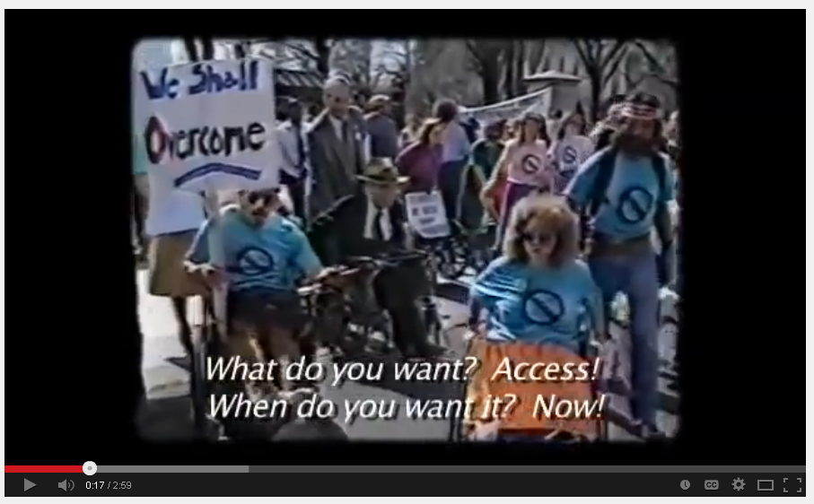
Activism: Capitol Crawl
video

Slide 31
Review of Resources
Ohio State’s Accessible Classroom Technologies Wiki, https://carmenwiki.osu.edu/display/10292/Home
DO-IT: Disabilities, Opportunities, Internetworking, and Technology at University of Washington, www.washington.edu/doit/
The Microaggressions Project, http://microaggressions.tumblr.com/tagged/ability
Project Implicit, https://implicit.harvard.edu/implicit/
Center for Leadership in Disability at Georgia State University, http://disability.publichealth.gsu.edu/

Slide 32
QUESTIONS?

