Slide 1
Syllabus Yoga:
Promoting Healthy Flexibility for Attendance/Deadline Policies
Adam Crawford, The Ohio State University
Alex Ecklund, Ohio University
Tiffany McClain, Columbus State Community College
Amanda Weyant, Kent State University

Slide 2

Agenda
Overview of attendance
accommodations
Each institution’s:
  Historical context
  Current process
  Lessons Learned
Q&A

Slide 3
Overview of Attendance Accommodations
Qualifying for attendance accommodations:
  Unpredictable disability-related flare-ups
  Includes both mental health and medical conditions
  Does not include executive functioning deficits
Nature of attendance accommodations:
  Broad reach, includes makeup work/exams (not just # of absences)
  Goal: develop proactive plan (not retroactive)
  Only reasonable amount of flexibility (not unlimited)
  “Reasonableness” determined by course design (not medical details)
  Student’s prompt communication w/ instructor expected (barring hospitalization)
  Students should not negotiate with instructors over the “substance of their accommodations” (from OCR Letter to Metropolitan State College of Denver)

Slide 4



Brutus Buckeye in
“Warrior 2” Pose

Slide 5
OSU: Historical Context
Prior to SP16: Attendance accommodations not “official”
  Not in handbook or bulleted accommodation list
  Only described as a recommendation on student letters
Re-evaluated after attending AHEAD 2015 Conference
Considerations:
  “Best practice” model: DS staff as primary contact
  Increase in workload vs. institutional support for additional staff
  Student should not “negotiate” their accommodations

Slide 6
OSU: Current Process
New official accommodation: “Attendance/Deadline Modifications”
New letter: “Attendance/Deadline Letter”
  p. 1/2 – guidance, includes examples and invitation to consult
  p. 3 – template form to put agreement in writing (alternative formats ok)
Procedure:
  Student presents letter to instructor for them to read guidance
  Instructor proposes modifications to student
  If acceptable to student, agreement is put in writing and submitted to DS.
  If not acceptable, student notifies DS. We follow up with instructor.

Slide 7
OSU: Lessons Learned
Added “Deadlines” to name after instructor feedback/confusion
Used excerpts from real-life agreements for examples page: http://go.osu.edu/attendancemod
Consider the additional workload and institutional culture around additional staffing requests
Set clear expectations for students around usage, communication, timeliness, and contingency plans
Consider how to address some instructors’ tendencies for vagueness

Slide 8



Rufus Bobcat in Tree Pose
Notes:
Alex you have 7-8 minutes

Slide 9
Historical Context
Flexibility typically includes attendance, deadlines, and make-up exams as one mostly related issue (barriers stemming from the same impacts)
Plan A-“flexibility with…” was listed on student’s letters and they were asked/expected to talk with instructors about these accommodations the same way they would coordinate exams or any other accommodation.
  Student follow-through issues/concerns
  Instructor follow-through issues
Plan B – Coordinators would reach out to instructors to notify them of eligibility of said accommodations and ask for copies of syllabi/policies
  Very little follow-up with students
  Instructor follow-through issues again
Plan C….

Slide 10
Current Process (Plan C)
Student initiates the request
Coordinator follows up with the student to schedule an appointment
Student and Coordinator review syllabi and concerns – talk about potential flexibility
Coordinators follows up with instructors regarding specific recommendations and syllabi citations
Flexibility gets documented in a student’s case notes once agreement is reached

Slide 11
Lessons Learned
We probably should have “primed” faculty for our shift in policy.
It’s easier to start with something than it is to start with nothing.
  How do we create as few steps or contacts as possible while also not cutting corners?
Finding a balance with instructors.
  Stepping back to reassess what creates access instead of getting bogged down in the routine.
Not always as timely as we or the faculty would like.
Treat them as “university approved” can be an in and a paradigm shift for instructors.

Slide 12


Clawdette Cougar in Dragonfly Pose

Slide 13
CSCC: Historical Context
The Accommodation: Around 2012 we made our first attempt at formalizing an accommodation related to attendance. The process was to send a letter to instructors that explained that the student had a disability that is episodic in nature, and that flexibility should be granted for the student with both attendance and assignment deadlines. The document didn't have any space for the student or instructor to write out the details of an agreement.
The Problem: We essentially handed the student a “blank check” on attendance and deadlines! This gave the student unrealistic expectations, made the instructor question the office’s judgement, and nearly led to legal difficulties more than once.

Slide 14
CSCC: Current Process
We later revised the UAP (Unscheduled Absence Plan) to be much more concrete, with input from both parties. Here is the process as it currently stands:
During the student’s intake, the student requests the accommodation, or the Advocate recommends it based on the documentation and student’s description of the disability.
The Advocate explains parameters of the UAP to student, and tells the student that this accommodation requires approval by the Advocate team before it can be instituted.
With approval of the team, the Advocate emails the UAP form to the student, with a clear explanation of the student’s responsibilities.
The student meets with his instructor, they agree on how work will be made up, tests taken, etc., in the event of an absence. Both student and instructor sign the document, then the student returns the document to his Advocate. The Advocate reviews the document, then sends back a copy to both the student and instructor.
This process must be repeated each semester with the student’s new set of courses and instructors.

Slide 15
CSCC: Lessons Learned
If multiple staff can approve the accommodation, it’s important that there’s consistency in how the decision to approve is made.
Instructors seem less resistant to the agreement when they have some input on it.
Be sure to give enough space on the form for the student and instructor to write out the conditions, otherwise you're inviting instructors/students to be vague. Communicate to the student and instructor when the statements are too vague; the UAP should not be considered in effect/accepted until after these revisions are made. It helps to reframe the requested revisions as a means to ensure that both the instructor and student are protected and that the expectations of all involved parties have been communicated clearly.
Students/instructors seem to frequently default to the potential examples listed on the form, so choose your examples wisely! Do not allow students/instructors to simply circle the examples as their selections. It is important that careful thought and consideration is taken to determine how the unscheduled absence plan will play out in the context of each particular class!
Allowing less than 48 hours to turn work in, or take a test, probably isn’t enough time to recover from a wide variety of flares. However, allowing longer than a week to get caught up could cause the student to fall even farther behind on current class material, leading to failure. The UAP has practical limits, so if a student falls far behind, even with the UAP, it’s important that they talk to their instructor and their Advocate about this. It might be that an administrative withdrawal is appropriate.

Slide 16



Flash in Half Moon Pose

Slide 17
KSU: Historical Context
Original accommodation: “unpredictable nature of a disability” that served mostly to advise instructors of possible absences. No official guidance regarding makeup opportunities.
Office advocated for Administrative Policy Regarding Class Attendance and Class Absence that lists disability specifically as a reason for an excused absence.
Students were originally required to meet with SAS each semester prior to being able to utilize attendance accommodation. Busy schedules caused significant delay in students using accommodation due to no fault of their own.

Slide 18
KSU: Current Process – Recently Updated
Students request Attendance Modification on their accommodation request through SAS Online Services (Accessible Information Management)
Accommodation letter contains statement outlining details of accommodation and link to SAS website for additional information and University policy.
SAS relies on faculty to report that attendance may be essential to the course. This prompts further discussion about course learning outcomes, interactive discussion, and participation requirements with instructor, chair, or dean as needed.

Slide 19
KSU: Lessons Learned
University policy that lists disability-related absences as excused provides significant support for attendance modification accommodations.
Students find it difficult to determine if attendance is essential to a course.
Regular student contact is helpful, but only if your schedules have room to see students quickly.
Find a balance of enough detail but not too enough information in the accommodation letter.

Slide 20

Q&A

Slide 21
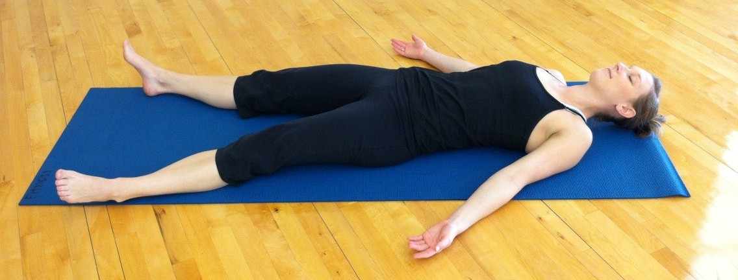
Thank you!
Adam Crawford: Crawford.843@osu.edu
Alex Ecklund: ecklund@ohio.edu
Tiffany McClain: tmcclain@cscc.edu
Amanda Weyant: aweyant1@kent.edu

