Slide 1
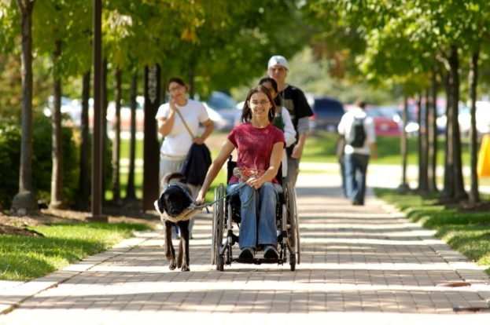
“Start to Finish - Providing Support & Resources for Students with Severe Physical Disabilities”
OH AHEAD Conference
October 23, 2015
Wright State University - Dayton, OH

Slide 2
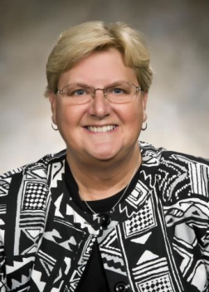
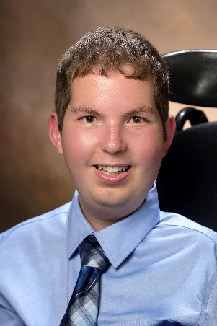
Presentation Team
Jean Denney Assistant Director for Physical Support Office of Disability Services
Wright State University
Jean.Denney@wright.edu
937-775-5686
Dan Darkow
Assistant Resident Director
Candidate, M.S.
Student Affairs in Higher Education
Miami University
darkowdc@miamioh.edu
513-529-5338

Slide 3
Why are you here?
Please tell us a little about yourself
Briefly share your name
Where you are from
Why you wanted to attend this session

Slide 4
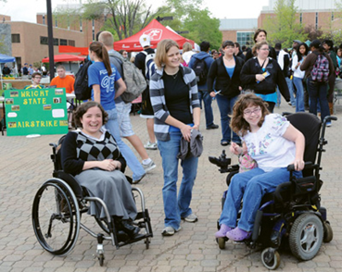
Learning outcomes
Be able to recognize 3 additional challenges SWSPD face in higher education
Identify core competencies SWSPD need to manage to be successful
Be able to articulate what is and is not your role in assisting a SWSPD
Evaluate an area on your campus that would be difficult for a SWSPD and think about possible changes

Slide 5
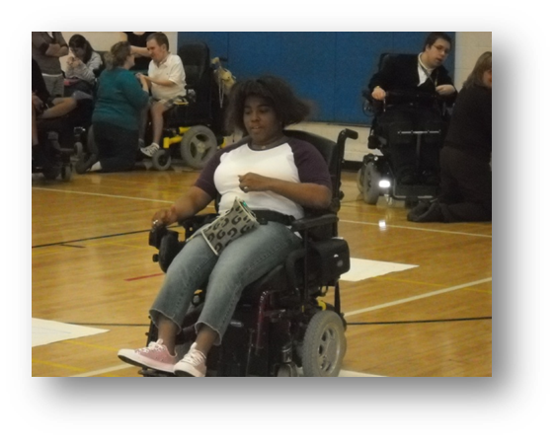
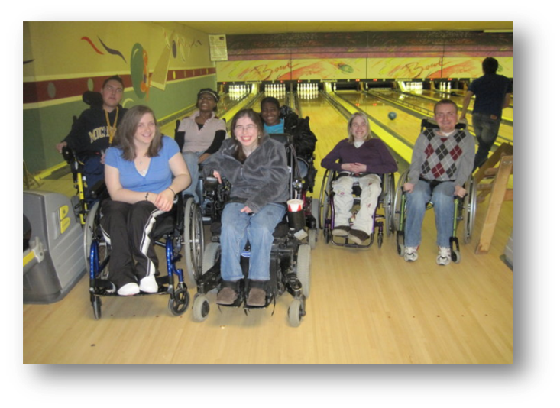
Students with Severe Physical Disabilities (SWSPD)
Disabilities including - CP, SB, MD, SMA, MS, Paraplegia, Quadriplegia, etc.
May use manual, power wheelchair, scooter, mobility aid or communication device
May require personal care assistance
Campus Access needs – disability parking, wc accessible shuttle, paratransit, door openers, elevator buttons, cafeteria assistance,
Campus Housing needs – single room, wheelchair accessible room, roll in shower, private restroom, electric door opener, hospital bed, Hoyer lift, etc.

Slide 6
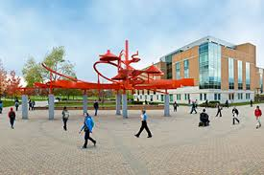
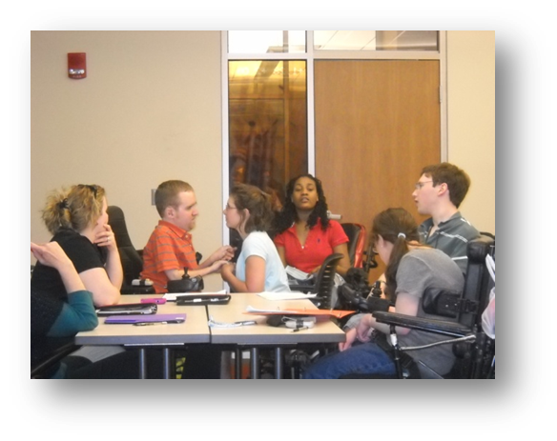
Students with Disabilities at Wright State University

Slide 7
Transition to College Common Challenges & Fears of FY Students
Responsibility
for self
Homesickness
Finances
Fear of
Failure
Academically
Where
do I
go to for
help
Safety
Health &
Fitness
Cooking
Cleaning
Laundry
oh my
Being on
my own
Getting
Involved
Roommates
Balancing
Time
Making
Friends

Slide 8
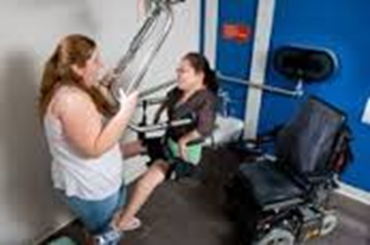
Additional Challenges of FY SWSPD
Change
Out of State
Increased
Responsibility for Self
Accessible
Transportation
Wheelchair
Repairs
Personal Care
Assistance
Assistive Technology
Medical needs

Slide 9
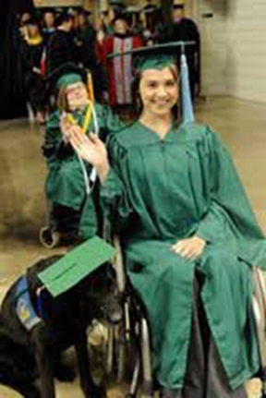
Educationally Based Philosophy
At Wright State we strive to create an authentic, inclusive living-learning experience that builds career skills, academic achievement, personal responsibility, interpersonal competence, and a promising future for young adults with disabilities.
The Wright State philosophy and educational approach focuses on fostering independence while helping students learn to make positive life choices. Self-determination for each student can be achieved through courses, programs, and support services that teach the development of problem solving skills, independent and interdependent learning, self-awareness, self-advocacy, and leadership opportunities.

Slide 10
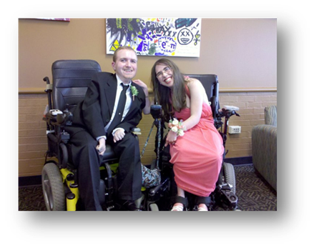
Core Competencies
Self
Advocacy
Self Awareness
Self Determination
Independent Living Skills

Slide 11
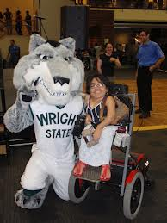
Individual Development Theory
Theory of involvement contends; the amount of energy- both physical and psychological- that students expend at their institution affects their development during college.
Astin, 1996; Kuh, Douglas, Lund,
Ramin-Gyurmek,1994

Slide 12
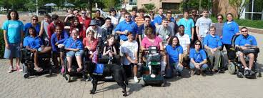
Why does it work at WSU?
Campus
Culture
Commitment
Collaboration
Communication
Care

Slide 13
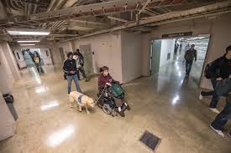
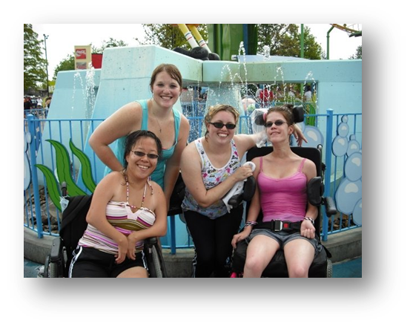
Creating a Welcoming Campus Culture for SWSPD
Universal design
Underground tunnels connecting academic buildings
Elevators with lower control panels
Restrooms without doors
Electric door openers on building main entrances and offices
Adjustable height tables in classrooms
Total electric door openers available in campus housing (fee based)
Ample disability parking
Accessible campus shuttles & paratransit service
Unique services & programs: Adapted Recreation, Wingerd Service Dog Park, PA,

Slide 14
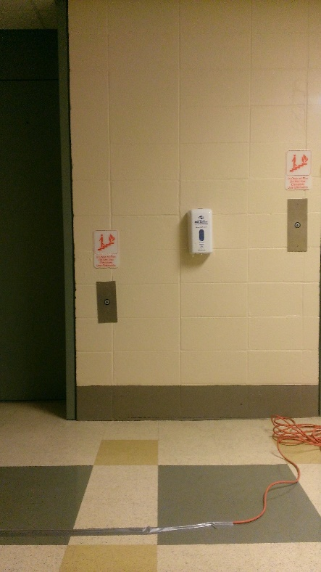
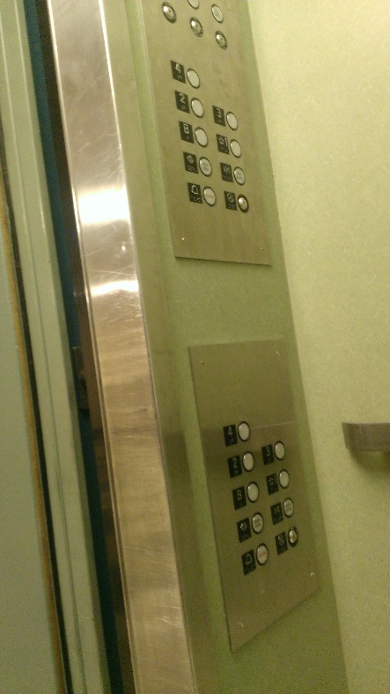
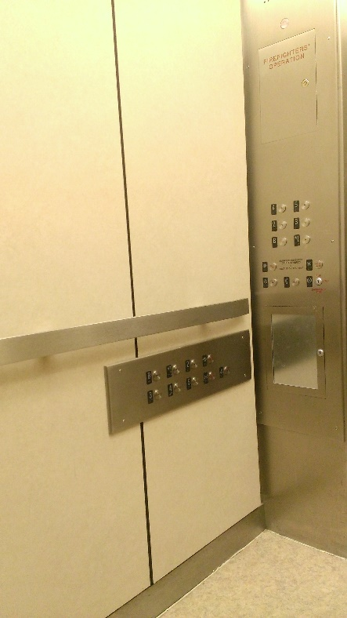
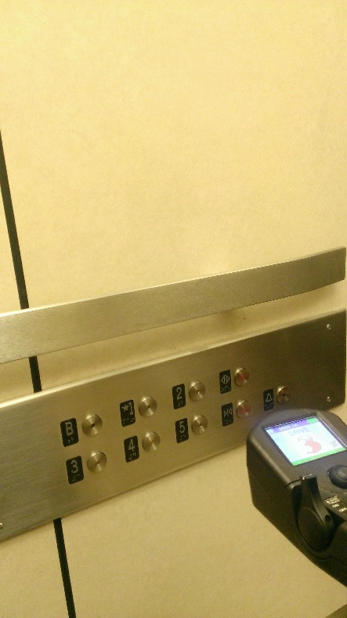
EXAMPLE using an elevator
An environment where SWSPD are able to open
and use the elevator independently without assistance
Are we thinking proactively or reactively?

Slide 15
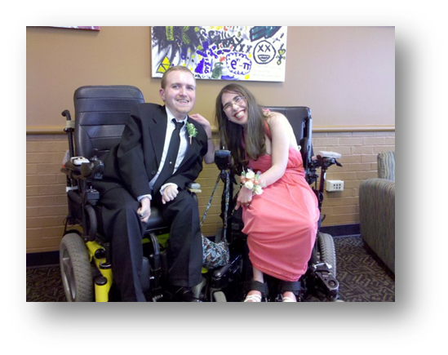
Collaboration with other Campus Resources
Campus Housing (RLH)
Student Support Services (SSS)
Student Activities (SA)
Campus Recreation (CREC)
Career Services (CS)
Student Success Center (SSC)
Student Health Services (SHS)
Counseling & Wellness Center (CWS)
Community Standards and Student Conduct (CSSC)
Campus Police (WSU PD)
Others?

Slide 16
What is and is not your role?
College selection and options
Review differences between high school and college
Discuss college readiness
Discuss importance of self advocacy and self determination
Discuss advance preparation for a successful transition & college experience
Discuss follow along support available from DSS
Inform about campus supports and resources available
Make recommendations and referrals off campus resources
Providing reasonable accommodations
Guarantee student success
Provide a false level of confidence
Provide personal transportation services
Provide personal assistive technology
Provide personal care support services
Assume responsibility for solving all problems

Slide 17
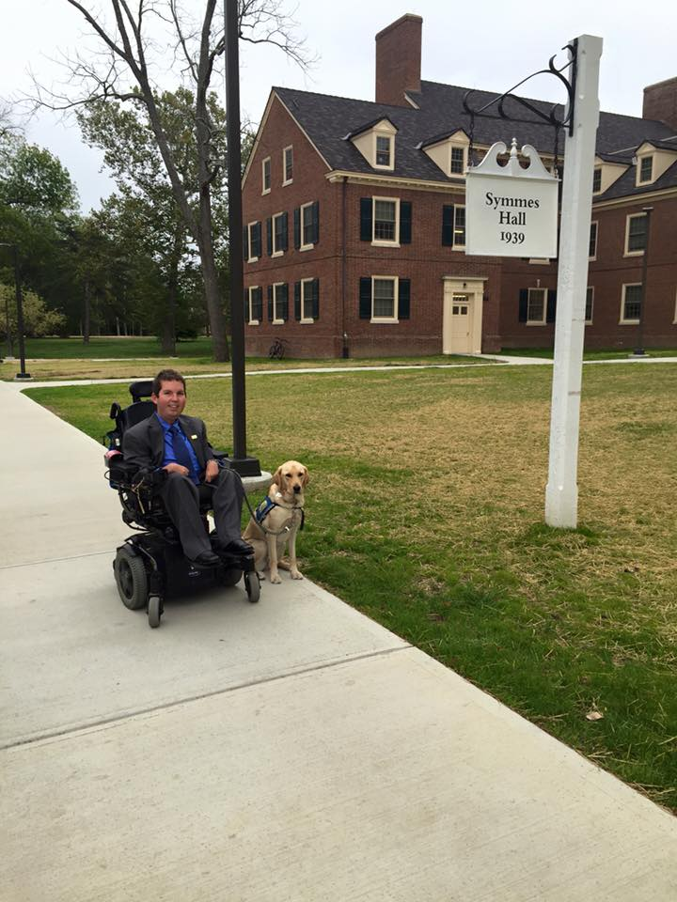
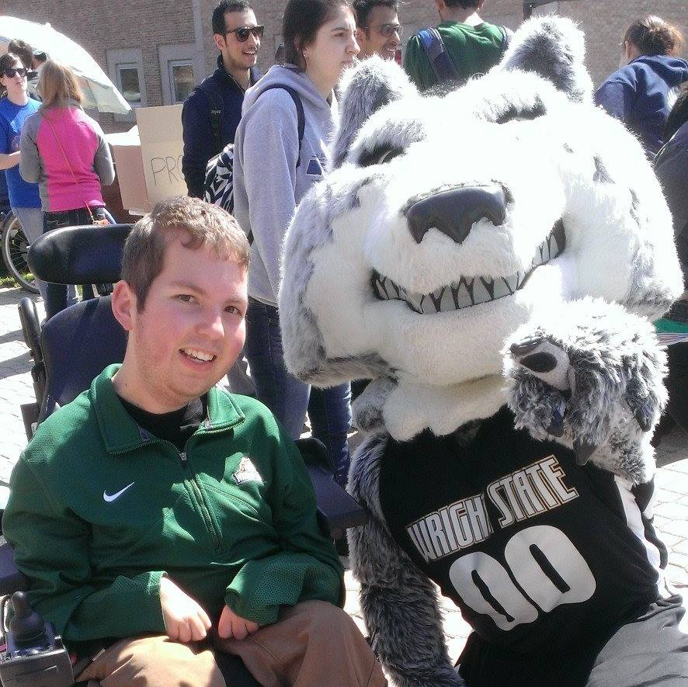
Discussion around experiences Dan Darkow at Wright State & Miami University

Slide 18
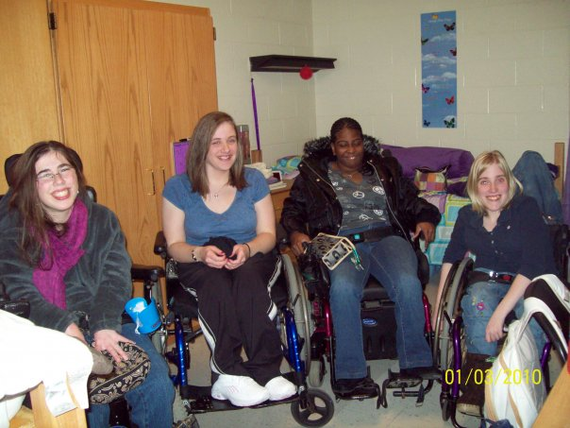
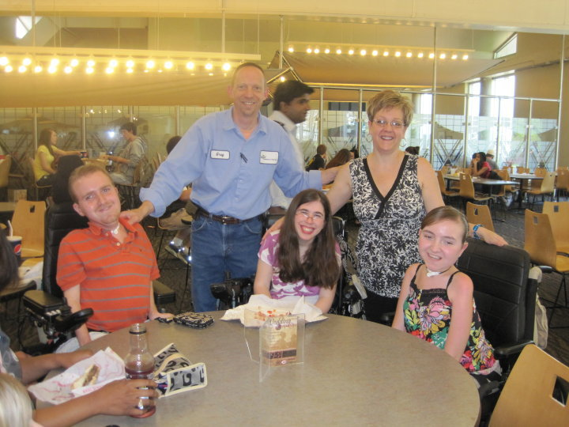
Action Steps
Who are the students on your campus and the prospective students?
What are their needs?
Start small
Don’t be afraid to make mistakes
Remember - it’s all about the students

Slide 19
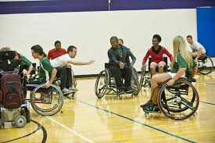
Next Steps
Expanding Adapted Rec & Athletic opportunities
Encouraging SWSPD to become involved in student organizations, SG, RCA, Advisory boards, and student employment
Increasing scholarships for incoming SWSPD
Increasing study abroad opportunities
Streamlining challenges with Medicaid Waiver programs for out of state SWSPD

Slide 20
Questions, comments, discussion...
Thank you for
attending!

