Slide 1
Reaching and Supporting Student Veterans
Adam Crawford
Student Life Disability Services

Slide 2
STUDENT LIFE DISABILITY SERVICES
Goals:
Identify barriers to student veteran participation in disability services
Review OSU’s student veteran outreach initiative
Brainstorm how this could work on your campus

Slide 3
STUDENT LIFE DISABILITY SERVICES
Pair/Share:
What struggles do student veterans go through in their transition to campus life?
What barriers do student veterans experience in connecting with disability services on your campus?

Slide 4
Student Veteran Community Advocate Program

Slide 5
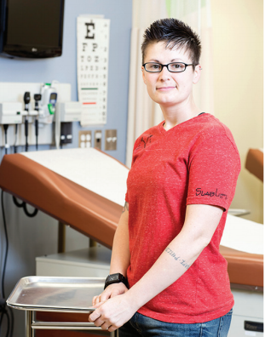
Amanda Hostetter
Student Veteran Advocate

Slide 6
STUDENT LIFE DISABILITY SERVICES
Literature Review:
JPED Special Issue (Vol. 22, Issue 1)
likely 40% of student veterans have a disability
DS language/processes off-putting
Missing:
*what* new language?
*which* new processes?

Slide 7
STUDENT LIFE DISABILITY SERVICES
Created online survey, partnered with Center for the Study of Student Life
Incentive: three $50 BuckID credits
Sent to 864 student veterans
192 responses (22% response rate)

Slide 8
STUDENT LIFE DISABILITY SERVICES
Disclaimer:
No IRB
Not generalizable research
Data is OSU-specific

Slide 9
STUDENT LIFE DISABILITY SERVICES
52% - self-identified as disabled
Top 6 Most Prevalent Conditions:
Anxiety = 1/4
PTSD = 1/5
ADD/ADHD = 1/5
Deaf/HoH = 1/5
Concentration/Processing = 1/6
Depression/Bipolar = 1/6

Slide 10
STUDENT LIFE DISABILITY SERVICES
Comfort Level with Terminology
Disability | Exceptional Need | Qualifying Condition | Injury | Illness | Impairment
18.4% | 9.2% | 40.2% | 49% | 24.5% | 28.6%
Accommodations | Academic Assistance | Academic Access | Exceptional Needs Services | Support Services | Access Services | Resource Center
48% | 55.7% | 58.2% | 22.5% | 57.2% | 49% | 68.4%

Slide 11
STUDENT LIFE DISABILITY SERVICES
Respondents with disabilities:
1/3 unaware of DS services
4/5 not registered with DS
9/10 satisfied with list of DS services
1/4 less likely to register with DS b/c of “disability” label
1/2 rather talk to student veteran first
3/5 want veteran-specific counselor

Slide 12
STUDENT LIFE DISABILITY SERVICES
Reasons for not registering:
Unaware of services
Didn’t know that I qualified for services
Didn’t want to be labeled
Didn’t want to burden the system
Pride / Self-Reliance / perceived as weak
Confusing/burdensome registration process
Perceived lack of anonymity/confidentiality

Slide 13
STUDENT LIFE DISABILITY SERVICES
Focus Groups:
What makes an office veteran-friendly?
Expectations of student veteran advocate?
Expectations of veteran-specific counselor?
Appropriate outreach vs. being condescending
Hot cards / language

Slide 14
STUDENT LIFE DISABILITY SERVICES
Moving Forward:
Veteran-specific DS Counselor
Veteran-specific hot cards
Advocate available to meet with student veterans
Revamp DS information on Veterans Office website, and vice versa
Quicker VA disability verification process

Slide 15
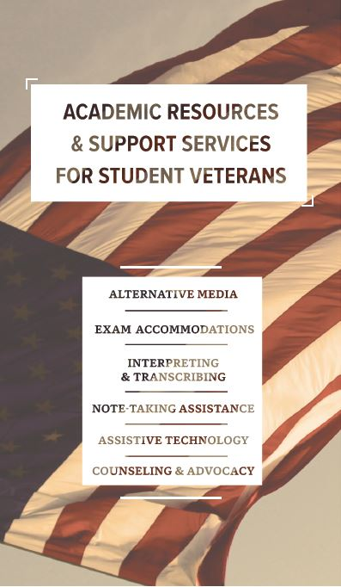
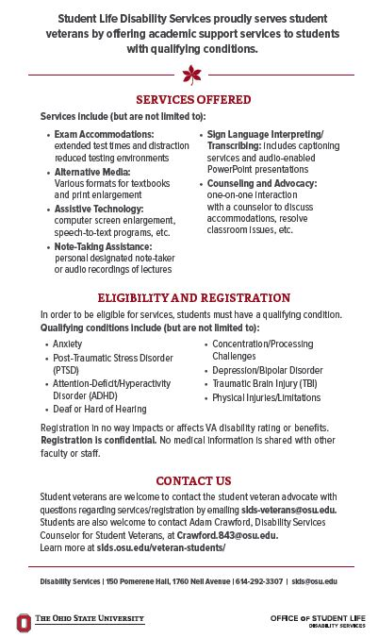
STUDENT LIFE DISABILITY SERVICES

Slide 16
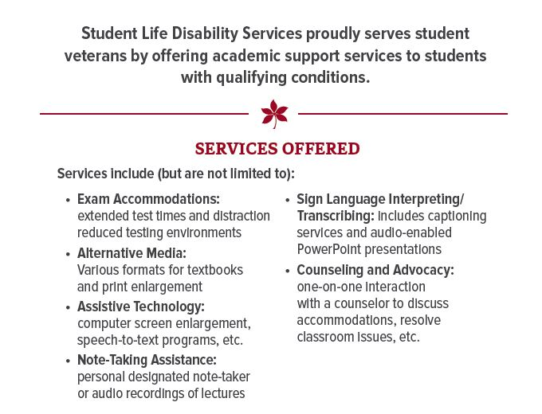
STUDENT LIFE DISABILITY SERVICES

Slide 17
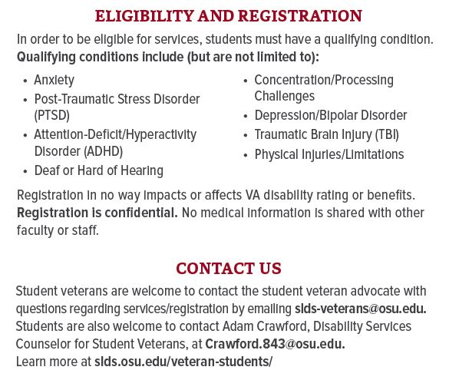
STUDENT LIFE DISABILITY SERVICES

Slide 18
STUDENT LIFE DISABILITY SERVICES
Future:
Similar survey to general population
Programming
Welcome poster
Outreach at veterans events

Slide 19
Questions?

Slide 20
STUDENT LIFE DISABILITY SERVICES
Pair/Share:
What can your office do to better reach student veterans?
What opportunities for partnerships or collaborations exist?

