Slide 1
The Transition Pitfall: The Role of the DS Provider in Building a Bridge
Carey Busch, Ph.D., CRC
Chris Linscott, M.Ed.
Ohio University

Slide 2
Checking In
Text CAREYBUSCH886 to 22333
OR
Go to: https://PollEv.com/surveys/eEgydY3OP/web

Slide 3
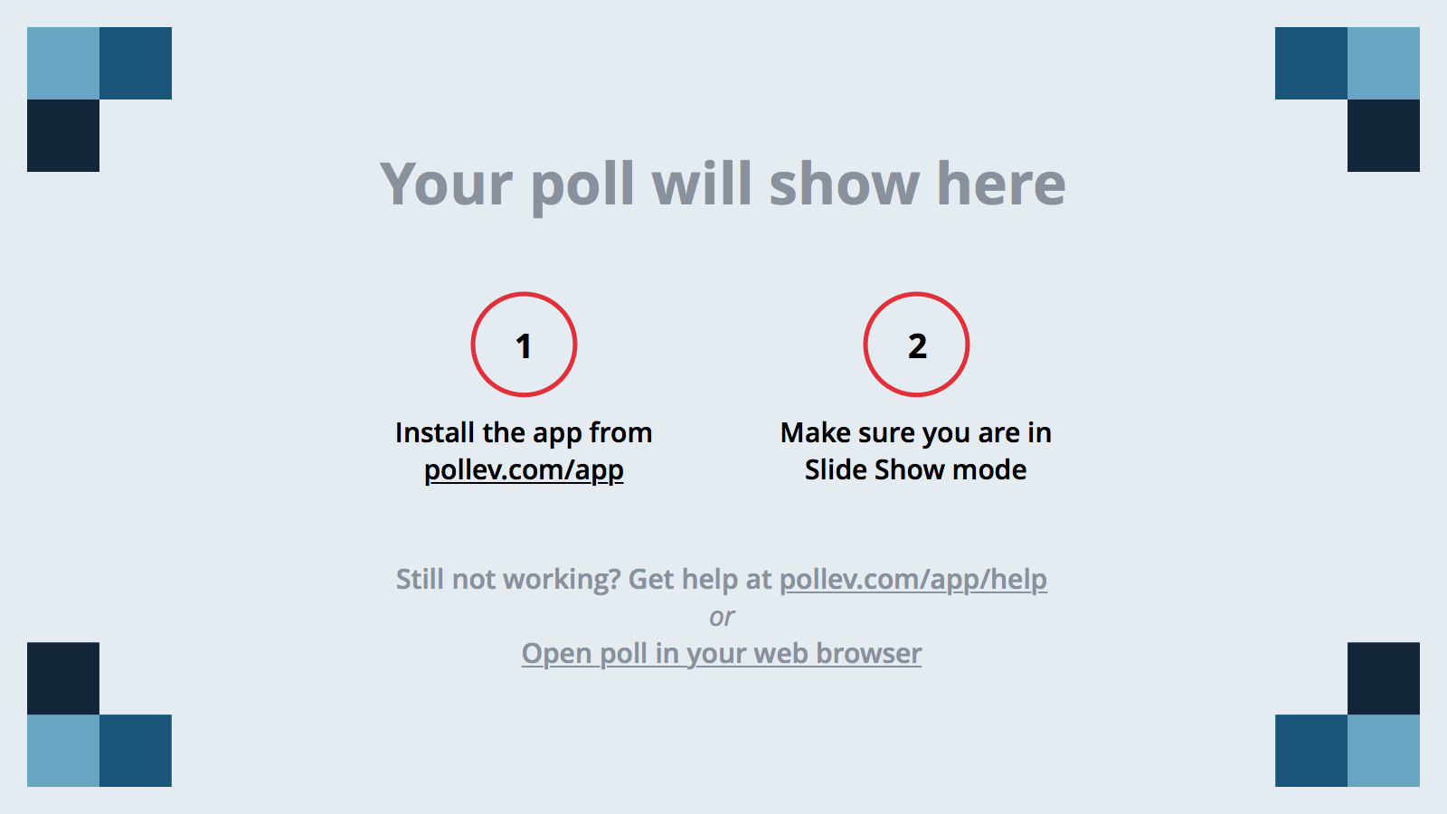
Notes:
What have you observed to be the biggest barrier for successful transition to postsecondary education?
https://www.polleverywhere.com/free_text_polls/0A7oiRCNuzFFP7d

Slide 4
Notes:
I feel confident in my understanding of evidence-based predictors that assist in transition to postsecondary education?
https://www.polleverywhere.com/multiple_choice_polls/itQc7G3AbEpS4Eu

Slide 5
Notes:
Who is responsible for promoting successful transition to postsecondary education?
https://www.polleverywhere.com/free_text_polls/2ynBeht6C4n5FEL

Slide 6
Notes:
My outreach to high school students can be described as:
https://www.polleverywhere.com/multiple_choice_polls/uLGDXkZ0vpX8tRk

Slide 7
Notes:
My biggest barrier to active outreach to high school students is:
https://www.polleverywhere.com/free_text_polls/eRtc1La56vYgPM7

Slide 8
Background to the Problem
Students with disabilities do not participate in higher education at the same rate as their peers without identified disabilities.
In Ohio, only one third of students with IEP’s enrolled in higher education in 2013 as of one year after graduation (source, OLTS, 2015).
People with disabilities are more than twice as likely as people without disabilities to report that they have a household income of $15,000 or less (34% versus 15%). (Kessler Foundation and National Organization on Disability, 2010)
National Center for Education Statistics states that in 2014, average salaries for young adults with a college degree were 66% higher than those with a high school diploma. (National Center for Education Statistics. http://nces.ed.gov/programs/coe/indicator_cba.asp)

Slide 9
How To Measure Success?
Many ways to measure success…
How we define success determines the impact of the domains being measured (i.e., higher education enrollment, graduation, employment, etc.)
For these purposes, transition success might best be defined as the ability to achieve reasonable, self-identified post-secondary goals.

Slide 10
Evidence Based Predictors of Post-Secondary Success for Students with Disabilities
Interagency Collaboration
Career Awareness
Community Experiences
Occupational Courses
Inclusion in General Education
Exit Exam Requirements/H.S. Diploma
Paid Employment/Work Experiences
Parent/Family/Guardian Involvement
Program of Study
Self-Advocacy/Self-Determination
Self-Care/Independent Living Skills
Social Skills
Student Support (source: OEF, 2015;Test & Cease-Cook, 2012).

Slide 11
Evidence Based Predictors Continued
Predictors are associated with increased success in transition to higher education, post-school employment, and independent living skills.
For current purposes, will concentrate on predictors most closely aligned with successful transition to higher education.

Slide 12
Evidence-Based Predictors: Increasing Post-Secondary Participation and Success
Career Awareness*
Inclusion in General Education
Interagency Collaboration*
Occupational Courses
Paid Employment/Work Experiences
Self Advocacy/ Self-Determination*
Social Skills
Self-Care/ Independent Living Skills
Student Support*
Transition Program
Community Experience*
Interagency Collaboration*
Parent/Family/Guardian Involvement *
* Denotes GTS area of emphasis
(Source: Mazzoti et al., 2013; OEF, 2015)

Slide 13
AHEAD Professional Standards
Administration
Direct Service
Consultation/Collaboration
Institutional Awareness
Professional Development
AHEAD Professional Standards, retrieved from https://www.ahead.org/learn/resources

Slide 14
Consultation/Collaboration
Working with campus or community personnel and agencies regarding students with disabilities or disability issues.
Consults with state, provincial, or community resources (e.g., rehabilitation services).
Collaborates with physical plant to ensure modifications to campus facilities.
Maintains up-to-date knowledge of adaptive technology.
Collaborates with campus architects to review or plan new construction and renovations.
Conducts campus-wide disability awareness activities (e.g., disability awareness day).
Communicates program activities to campus community (e.g., via campus newspapers).
Conducts outreach activities for high school students (e.g., college fairs, transition workshops).
Consults with campus personnel regarding job accommodations for faculty and campus staff with disabilities.
AHEAD Professional Standards, retrieved from https://www.ahead.org/learn/resources

Slide 15
Gateway to Success
One-day program targeting high school juniors
Focused on career exploration
Presents ways to get financial assistance
Introduces concept of obtaining services and support
GTS is, in many ways: a form of Interagency Collaboration; a means of Career Exploration to further Career Awareness; a Community Experience; a way to increase Parent/Family/Guardian Involvement; an opportunity to further Self-Advocacy and Self-Determination; and, a means to create an additional layer of Student Support

Slide 16
Gateway to Success – Installation of Hope
One somewhat less easily categorized opportunity, both for the Gateway to Success program, and, for those of us working with transition students and their families is the Installation of Hope!
An important way to view Hope is as an opportunity for students with disabilities to connect real Self-Efficacy with the means for Self-Determination.
GTS creates a unique opportunity to encourage transition students in furthering hope for, and belief, in themselves.

Slide 17
Gateway to Success - Metrics
At the end of the program students are asked two simple questions:
What is one thing you learned about yourself today?
And
Who are two people you will talk to about your plans for postsecondary education?

Slide 18
Gateway to Success - Budget
For 25 students the costs for GTS are:
$150 for Strong Interest Explorer
$300 for lunch
$25 supplies
Total: $475
You could use a free career tool such as: https://www.onetcenter.org/tools.html or https://jobseeker.ohiomeansjobs.monster.com/ExploreIt/Default.aspx
You could have students bring their own lunch

Slide 19
Looking Beyond Gateway
While GTS is one way SAS at Ohio University has found to partner with secondary schools to increase transition outcomes of students with disability in our area, it is not the only way!
Our future hopes include:
Getting GTS included in transition plans for students
Follow up visits with GTS students
Serving as consultants for local students who wish to transition
Developing a sophomore and senior experience
We ultimately envision the creation of a pipeline program beginning in middle school

Slide 20
How about you?

Slide 21
Take Away…
What is one thing that you learned today that changed your thinking about transition?
What are two things you will do to increase your outreach to high school students?

Slide 22
Sources
Association for Higher Education and Disability (N.D.). AHEAD Professional Standards. Retrieved from https://www.ahead.org/learn/resources
Center for Innovation in Transition Study (2015). Ohio Longitudinal Transition Study Annual report. Retrieved from: https://education.ohio.gov/getattachment/Topics/Special-Education/Resources-for-Parents-and-Teachers-of-Students-wit/Ohio-Longitudinal-Transition-Study-OLTS/FINAL-OLTS-STATE-REPORT-2015-4-8-4.pdf.aspx
Kessler Foundation and National Organization on Disability (2010). The ADA 20-years Later. Retrieved from http://www.2010disabilitysurveys.org/pdfs/surveysummary.pdf

Slide 23
Cont.
Mazzotti, V. L., Rowe, D. A., Cameto, R., Test, D. W., & Morningstar, M. E. (2013). Identifying and promoting transition evidence-based practices and predictors of success: A position paper of the Division on Career Development and Transition. Career Development and Transition for Exceptional Individuals, 2165143413503365.
National Center for Education Statistics. (2016) Annual Earnings of Young Adults http://nces.ed.gov/programs/coe/indicator_cba.asp
Ohio Employment First (2016). Evidence based practices for transition youth. Retrieved from: http://www.ohioemploymentfirst.org/up_doc/Evidence_Based_Practices_for_Transition_ Youth.pdf
Test, D. W., & Cease-Cook, J. (2012). Evidence-based secondary transition practices for rehabilitation counselors. Journal of Rehabilitation, 78(2), 30-38. Retrieved from http://search.proquest.com.proxy.library.ohiou.edu/docview/1010282866?accountid=12954

