Slide 1
Thoughts for session
Bring in ideas of serving others as a way to energize
Work-life balance of just life??? Wear multiple hats? Multiple roles?
Bring circle document!!
Flow
Craig Groeschel dissatisfied thoughts?? Compare, always want more, …
Any Brene Brown thoughts???

Slide 2
Serving others and importance in life

Slide 3
Accommodating yourself

Slide 4
Think about…
Your spiritual beliefs
Your work/vocation contributions
Your family
Your friends
You

Slide 5
What Legacy do you want to leave behind?

Slide 6
How do you intentionally (or not) work toward this legacy?

Slide 7
What is most important to you?

Slide 8
What do you most often spend your time doing, pursuing and accumulating?

Slide 9
How does your important priorities align with your daily actions?

Slide 10
Action step: Start with why

Slide 11
WHY:
Purpose?
Cause?
Belief?
Vision?
Ideals?
Essence of who you are
Why do you get out of bed Monday morning?

Slide 12
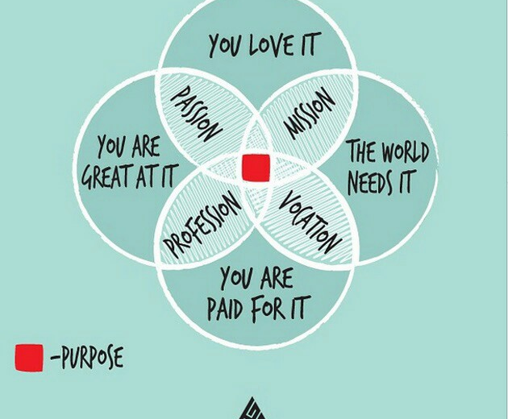
From Hustle + Grind (Entrepreneur resource)

Slide 13
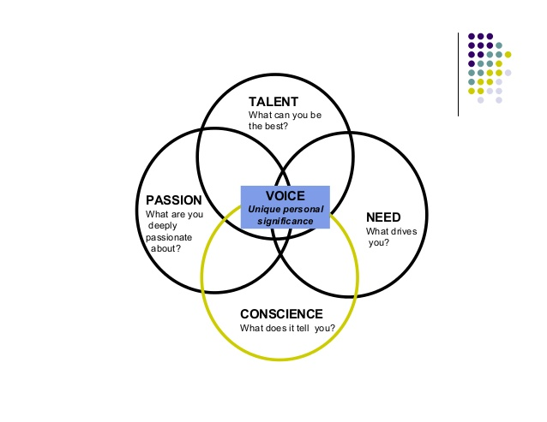
Finding your voice
From the 8th Habit if Highly Effective People

Slide 14
Why do you do what you do?
What is your WHY with respect to your job (and life)?
Why do you get out of bed on Monday morning?
Identify how your job aligned with the essence of who you are, your passions, beliefs and values.
Take 2 – 3 minutes to think about your personal WHY with respect to your work and identify 2 – 3 responses
Mental notes
List of thoughts
Use circle to capture visually or in writing
Share personal WHYs with others (groups of 3 - 4)

Slide 15
https://hbr.org/2016/04/how-to-get-into-a-rhythm-at-work-if-you-cant-stick-to-a-schedule?cm_mmc=email-_-newsletter-_-management_tip-_-tip_date&referral=00203&utm_source=newsletter_management_tip&utm_medium=email&utm_campaign=tip_date

Slide 16
What is balance in life? (Michael Hyatt)
Balance is not the same as rest.
Balance is about distributing demands so we can stay on track. And sometimes that takes a lot of work.
Balance is dynamic.
“Life is like riding a bicycle,” Albert Einstein said. “In order to keep your balance, you must keep moving.”
Balance requires tweaking our schedule, task lists, and more. If you have it right one week, it still requires attention the week.
Balance is intentional.
We have to make purposeful decisions and actions if we want balance. It’s not accidental.
Those decisions and actions will look different for each of us, but they’re essential for all of us just the same.
We might be tempted to look at work-life balance as a sort of get-out-of-jail-free card. If we just get the right combination of job, family, rest, and hobbies going in our favor, then we’re home free. But that’s just magical thinking.

Slide 17
A challenge to achieving Balance: Perfectionism (Shauna Niequist)
Dissatisfaction in the present drives the vision for a better future for our team, our family and ourselves.
At some point, good clean work became something else: an impossible standard to meet, a frantic way of living, a practice of ignoring my body and my spirit in order to prove myself as the hardest of the hard workers.
Beware of the cost of striving for perfectionism (health, emotional, relationships, physical well-being)
Listen to your body and the notice the impact of stress
Know how to reset

Slide 18
Will this matter 1 week from now? 1 month from now? 1 year from now? 10 years form now?
-- Craig Groeschel

Slide 19
Ideally…
Strive for meaningful daily achievement and enjoyment in as many of these five important life areas as possible:
Spiritual
Work
Family
Friends
Self

Slide 20
What is spirituality?

Slide 21
It is the small things that people do that no one sees that lead to the big things that everyone sees and wants.
-- Craig Groeschel

Slide 22
Action step: Know the difference between important and urgent

Slide 23
Important over urgent

Slide 24
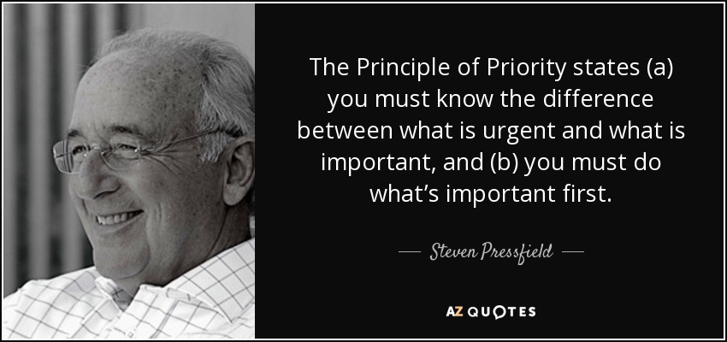

Slide 25
Difference Between Important and Urgent
Urgent: Dealing with angry professors who are complaining about unclear accommodation letter information
Important: Spending time building an accommodation letter that best addresses the needs of professors and addresses the ambiguity
Urgent: Engaging with a partner/spouse who is angry and annoyed with you because you have not spent quality time with that person
Important: Having a weekly date night for definitive interaction and building in other times over the week to intentionally connect
Urgent: Frequent doctor office visits or days in bed because not feeling well
Important: Eat right, exercise, manage stress, and say “no” so as to best take care of body

Slide 26
Keys to Managing the Important
Create artificial deadlines (deadlines that buy margin and that center on what is important)
Example: Supervisor wants report due at 5:00pm on Thursday. You commit to submitting it by 5:00pm on Tuesday.
Example: Leave work at 5:00pm every night (non-negotiable) so you can do what is important (go to gym, meal with kids, time with partner, walk in park, etc.)
Say “NO”
The most productive people do not do everything but they commit to doing what is most important relative to personal vision, mission and goals
Being busy is not a badge of honor
What brings you the most energy and the most life?

Slide 27
What is important to you?
Your spiritual beliefs
Your work/vocation contributions
Your family
Your friends
You

Slide 28
We have the time
Common phrases in our culture: “I cannot do __________ because I do not have the time.”
Craig Groeschel: We choose to do what we choose to do.
Time does not dictate how we use it but we dictate how we use time
Important?
Urgent?
Useless?
Inefficient?
Ineffective?
Connected to personal why?
Connected to those 5 areas of life?

Slide 29
Redefining Rich?
Those who have the most are often those who need the least.
-- Craig Groeschel

Slide 30
Action step: Be intentional

Slide 31
7 steps to being a more happy person (Michael Hyatt)
Become self-aware: What is it like to be around me?
Why do you choose to complain?
What are you trying to accomplish by complaining?
Complaining is a cheap but destructive way to connect
Decide to be more happy and complain less

Slide 32
Shift your identity
See yourself in a different way (as a leader, as a conscientious spouse or parent, as an athlete, etc.)
Greet others and interact with a smile
Catch other people doing something right. Show pleasure and gratitude
Speak well of others
If someone is gossiping or bad-mouthing another person to you, what are they saying about you to that other person?

Slide 33
Engagement vs. BurnOut
The Engaged Person
The Burnt-Out Person
Energized
Involved
Creative
Open
High-Performing
Clear expectations
Resources support demands
Experiences aligned with sense of self
Exhausted
Cynical
Close-minded
Overwhelmed
Under-performing
Feels unclear or conflicting expectations
Demands exceed resources
Experiences clash with sense of self

Slide 34
Three dimensions of burnout
Emotional Exhaustion
Impacts mental and physical stamina and abilities
Depersonalization
Alienation, cynicism and lack of care and investment
Reduced Personal Accomplishment
Under-achieving, mistake-prone, may be seen as uncooperative or lazy
-- From Monique Valcour

Slide 35
Costs of burnout
Greater health problems
Heart disease, depression, anxiety
More frequently sick and unable to function
Greater relationship tension
Decreased performance
Lower morale
Less willing to support and help others

Slide 36
Combat Burnout by…
Replenish your personal resources
Sleep, nutrition, exercise, positive relational experiences, and activities you enjoy
Analyze current situation
What is energizing you? (Do more of)
What is depleting you? (Explore how to do less of)
Make changes in your job to increase resources available
Changes to policies and practices?
Be intentional about regular reassessment
Mentor?
What can you change?
What is not changeable? Can you live with that or need to make a different change?

Slide 37
8 secrets to combat being overwhelmed (Michael Hyatt)
Accept responsibility
I am in this state because I made these commitments
Don’t be the victim
Confront your fears
It is okay to say no
FOMO – Fear Of Missing Out
Reduce the drama
Do you do things because it makes you feel important and look good?

Slide 38
Keep it in perspective
Look at the big picture of life and the season you are in at work, at home, and in your community
Watch your internal dialogue for it often becomes reality
“If something does not change soon, I will absolutely lose my mind and totally breakdown”
“Things are really busy right now but I can get through this and be stronger for it.”
Triage your calendar
Make sure you have enough white space (margin) to avoid over-commitment and to recover in ways that work for you
Delegate?
Delay action?
Say no?

Slide 39
Do the next most important task
What really needs to be done now and today?
Have a manageable task list for the day and accomplish it!
If consistently leaving tasks unfinished for the day, too much on your to-do list
Get sufficient rest and know how to recharge yourself
Intentionally spend time on those five life areas (spiritual, work, family, friends and self) in ways that create enjoyment and achievement
Decide to change

Slide 40
Action step: consider the ultimate purpose

Slide 41
The goal of our life is not to have our lives mean something for ourselves. The goal of our life is to have our lives mean something to others.
-- Simon Sinek

Slide 42
Next Steps
Identify at least one personal action step within at least one of the five life areas:
Spiritual
Work
Family
Friends
Self
Commit to doing at least one action so you will nurture at least one of these areas over the next 30 days

