Slide 1
It Takes a Village
Success Stories for Collaborative Partnerships
Adam Crawford, Caity McCandless,
Courtney McCrary, and Stephanie Rowland
The Ohio State University
10/21/16

Slide 2
Objectives
Why partner?
Review partnerships we’ve made
Test Anxiety / Student Veterans
STEM / Career Development
Residence Life / Trauma Victims & Survivors
Student Athletes / Substance Abuse Recovery
Ingredients for creating/sustaining successful partnerships
Questions

Slide 3
Why partner?
We can’t do it alone!
Partnerships benefit our population
Making the best use of resources / expertise
Keeps things interesting!

Slide 4
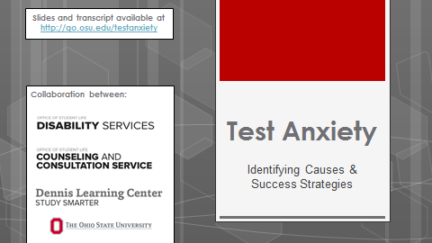
Test Anxiety
go.osu.edu/testanxiety

Slide 5
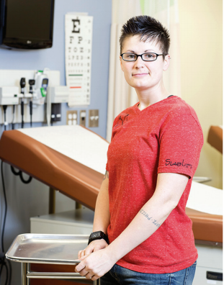
Student Veterans

Slide 6
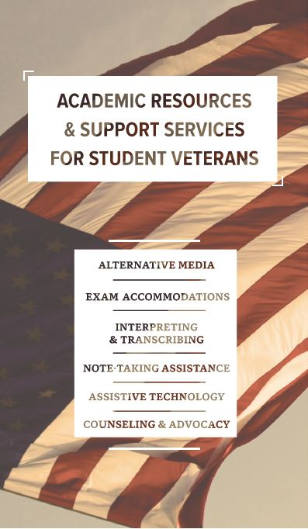
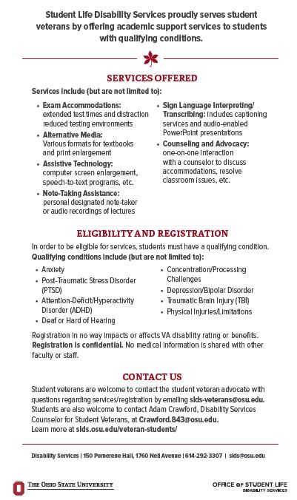
Student Veterans (2)

Slide 7
STEM Initiative
Co-advising Student stem organization (MOMENTUM)
Planned and implemented Students with Disabilities STEM Research Forum
Recruitment for STEM Choose Ohio First Scholarship

Slide 8
Career Development
Collaborated and implemented successful career mentorship program
Assisted with creating paid internship opportunities with local organization- OHBLN
Career readiness workshops
Recruitment opportunities
Disability and Career student conference

Slide 9
Residence Life
Leadership Team and Senior Staff-Summer/Fall Training
Qualifying Conditions
Registration Process
Accommodations and Services
Consultation and Collaboration Opportunities
Resident Advisors-Summer Training
Qualifying Conditions
Registration Process
Accommodations and Services
Supporting and Advocating
Programming Opportunities
Residence Hall Students-Various Halls thru Academic Year
Sighted Guide Training for Office Assistants
Disability as Diversity/Building Inclusive Communities

Slide 10
Trauma Victims & Survivors
Meetings/Training Sessions
Initial meeting with Assistant Director of SCE and Sexual Violence Support Advocates
Each department presents during staff meetings once a semester
Created a referral form and process
Student completes referral form to be sent to Disability Services
Disability Services assigns an Access Specialist
Students are provided temporary accommodations (until documentation is received)

Slide 11
SCE Referral Form

Slide 12
Student Athletes
Why build a collaborative relationship?
Identifies student-athletes that may have a disability
Allows SLDS and SASSO to tailor services to best serve each individual student
Makes it easier for student-athletes to utilize SLDS and SASSO services
Allows both SLDS and SASSO to understand the services available in both offices and the needs each office has
Creates an atmosphere where student-athletes feel comfortable utilizing the services with the least amount of hiccups as possible

Slide 13
Student Athletes (2)
Recruiting process
To be well informed of what accommodations they would be provided based on being admitted to the university and deciding to attend
Advocacy
Provide student-athletes with the training and information on how to become a good advocate
Explain the differences between high school and college accommodations & disclosure
Emphasize that if they do not do this for themselves that it is not going to magically get done
Also explain how what support SASSO will provide

Slide 14
Student Athletes (3)
Travel
Travel schedules for each student-athlete will be different. It is important to:
Look ahead in the syllabi to determine what some potential road blocks may be (conflict with exams/quizzes, impair study time, alter test times)
Determine if a test has to be taken while on the road so that accommodations with other universities can be made
Learning Styles
Understanding and communicate what limitations are based on their diagnosis
Set up tutoring properly based on the needs of the student
Not every student with the same diagnosis will have the same learning styles.
Confidentiality
Make sure you, your staff and your student-athlete understand that being registered at SLDS means that the disability cannot be disclosed to anyone without student-athlete permission. It will not be on the diploma or on any open-access school computer system.
The right to disclose a student-athlete’s disability is up to the student-athlete…not you

Slide 15
Substance Abuse Recovery
The Collegiate Recovery Community (CRC) is a program designed to support students in or seeking recovery from drug and alcohol addiction. The CRC and its programs allow students to have an authentic college experience while maintaining their recovery.
With confirmation of being in the program we give priority registration
Must meet to discuss additional accommodations

Slide 16
Discussion
What makes a successful partnership?
Who would you partner with? Why?

Slide 17
Ingredients for Creating Successful Partnerships
Understand your campus / partners / resources / opportunities
Identify area for collab., then identify who needs to be at the table
Know what you can fit on your plate / get creative
Choose your projects and partners with intention (in both offices)
Be brave! Start a conversation.
Build rapport (put a face with an office)
Agree on mutually-beneficial common goals
Discuss and value the needs/wants of all partners

Slide 18
Ingredients for Sustaining Successful Partnerships
Consider having a “project lead”
Good communication / organization
Regular check-ins; walk away with plan
Set realistic, self-paced expectations of work
Use collaborative e-tools (e.g. Google Docs)
Use people’s strengths
Be ok w/ lulls; pick it back up again!
Remember the purpose: let student success motivate you

Slide 19
Questions?

Slide 20
Thank you!
Adam: crawford.843@osu.edu
Test Anxiety / Student Veterans
Stephanie: rowland.245@osu.edu
STEM / Career Development
Courtney: mccrary.36@osu.edu
Residence Life / Trauma Victims & Survivors
Caity: mccandless.8@osu.edu
Student Athletes / Substance Abuse Recovery

