Slide 1
Coordinating Services to Assist in Retention Efforts
Julie Eagen, Director, Testing Services & Enrollment Analysis
Lesley Dorhout, Educational Advisor, College Success Program
Jennifer Radt, Sr. Director of Student Affairs & Services

Slide 2
Retention Affects Us All…
Session’s purpose:
share how three service units at UC Clermont have partnered to creatively participate in the college’s retention efforts
discuss ways your unit can participate in your home college’s retention plan

Slide 3
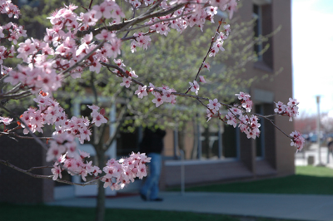
About UC Clermont
Regional Campus of the University of Cincinnati
2,800 +/- student enrollment
Rural location
2-year degree focus (technical and transfer degrees)
Large Appalachian population

Slide 4
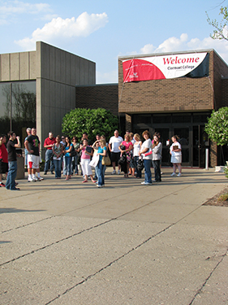
Clermont College Demographics
58% full-time
56% female
80% white (minorities are < 2% each)
32% “non-traditional” (age 25 or older)
All commuter students
More than 60% - 1st generation to attend college
Approximately 20% are underprepared in both English and Math
Fall 2015 to Fall 2016 retention rate: 61.1%

Slide 5
Disability Services
Provides academic support for students with disabilities.
Services approximately 220 students each semester.
Works closely with Testing Services to provide test proctoring.
Provides coaching for students.
Responsible for alternate text and assistive technology requests.
1 FT employee and 1 PT employee.

Slide 6
Testing Services
Services Offered
About
Placement testing
Accommodated test proctoring
CLEP
DSST
PearsonVue
Distance Learning proctoring
Program specific exams (TEAS V, AMP, HESI)
Prior Learning Assessment
Part of Academic Affairs
Primarily a student service
2 staff, 1 student worker & 1 contract proctor
Orientation responsibilities
Data tracking and analysis

Slide 7
College Success Program
Target audience:
Students testing into developmental English & math
Benefits:
Transitional courses prepare students for college level work
Personal & academic assistance
Study strategies and lifelong skills emphasized
Goal setting
Time Management

Slide 8
Barriers to Success
Student Support Services – not centralized
No formalized retention strategies
Placement testing not mandatory
College Success Program participation optional
No comprehensive services for underprepared students
Underutilization of services
Lack of understanding that we all have a role
No strategic effort to retain students with disabilities

Slide 9
Outside Influences on Retention
State funding changes in Ohio:
no longer based on day +16 enrollment.
based on course completion rates.
Enrollment decline = need to retain current students.
At-risk population = hardest to consistently retain.

Slide 10
Institutional Response to Retention
Increased awareness of student lifecycle (application → graduation)
Focused attention on role of student services
Faculty voted to mandate placement testing prior to Orientation/course placement AND mandatory placement in College Success Program if indicated by test scores

Slide 11
Challenges to Institutional Response
How to handle mandatory Placement Testing?
Culture change
Possibility of initial decrease in enrollment
How to require mandatory participation in College Success Program?
Quick timeframe
Resistance from students and faculty
How to increase use of services by students with disabilities?
Not required
Shift for Testing Services
How to provide quality service with small staff?

Slide 12
Implementation of Institutional Response
Mandatory Placement Testing
Increased communication to students, faculty and staff
Change in marketing materials
Role in Orientation invitation process
Mandatory participation in CSP
Communication to identified students prior to orientation
Specialized academic advisors
Frequent communication with Testing Services
Increase use of services by students with disabilities
Reduce barriers in terms of test scheduling
Increased communication to students
Personal introduction by Disability Services Staff

Slide 13
The Neighborhood Concept
Three units scattered across campus which hindered quality service
Three units co-located in 2015-2016 AY
Staff works in a team format
Staff covers for each other when necessary
Staff know students and collaborate when problem solving

Slide 14
)
Notes:
SLOs: Tech lit; campus resources; id academic programs and majors which fit; plan to complete assignments; skills( time & stress mgt, com etiquette); understand forces which affect career choice
Assessments: MI, learning styles, l/r brain; MBTI, values skills, interests

Slide 15
Change #1: Location

Slide 16
Results
Quantitative:
94% of incoming freshmen completed placement testing prior to enrolling in classes
95% persistence rate for full participation in CSP (n=78)
50% persistence rate for no participation in CSP (n=18)
Persistence rate fall to spring all UCC – 80.7%
Qualitative:
Increased collaboration among support services
Creation of Student Success Center

Slide 17
Accommodated Testing Data

Slide 18
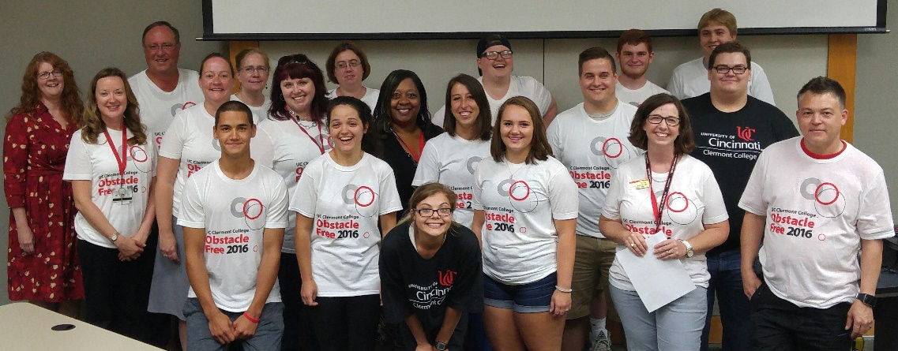
Obstacle Free 2016
Purpose:
remove barriers for specific student population
increase level of English and math
provide comprehensive program to include all student support areas

Slide 19
Obstacle Free 2016
Finances: $10,000; $5,000 in grants and a matching $5,000 from Clermont College.
Why $10,000?
Waiver of application fee ($50) for each student
Waiver of confirmation fee ($50) for each student
3-credit hour scholarship ($667) for each student
Remaining funds used for t-shirts, food and supplies.

Slide 20
Year Two Initiatives: 2nd chances → Retention
Academic recovery program:
Servicing academic alert/probation students
TS sends initial info to CSP
CSP sets up recovery plan
CSP monitors students through semester
TS tracks progress
Students are enrolled in a success skills class taught by neighborhood staff

Slide 21
What’s In It For DS Offices?
Multiple units have interaction with DS students
Creative way to share resources
Staff are cross-trained to problem solve a variety of issues

Slide 22
Action Steps for Your Campus
Review institutional retention goals & data
Discuss retention with colleagues
What programs work for our students?
How can our unit expand these exemplary programs?
Explore grants for potential retention ideas

Slide 23
Group Discussion
How are we all responsible for retention?
What additional steps could your office take in supporting retention efforts?

Slide 24
Contact Information
Julie Eagen, Director Testing Services
julie.eagen@uc.edu
Lesley Dorhout, CSP Educational Advisor
lesley.dorhout@uc.edu
Jennifer Radt, Sr. Director
jennifer.radt@uc.edu

