Slide 1
Are your… ☑ Website ☑ Shared computers & ☑ Learning Management Systems ACCESSIBLE TO ALL?
www.sitecues.com

Slide 2
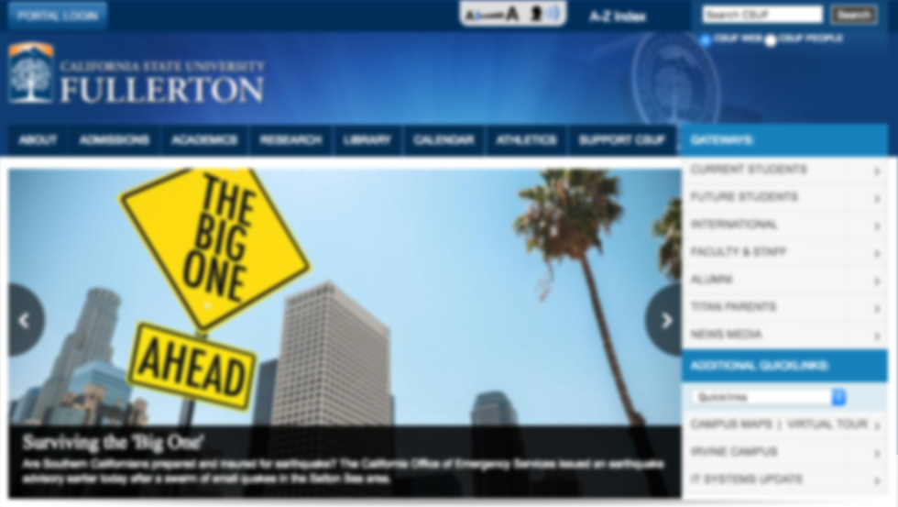
How effective is your website
to visitors who see this?
www.sitecues.com
Over 150 million people in the US have print disabilities,
and over 95% of them do not use Assistive Technology

Slide 3
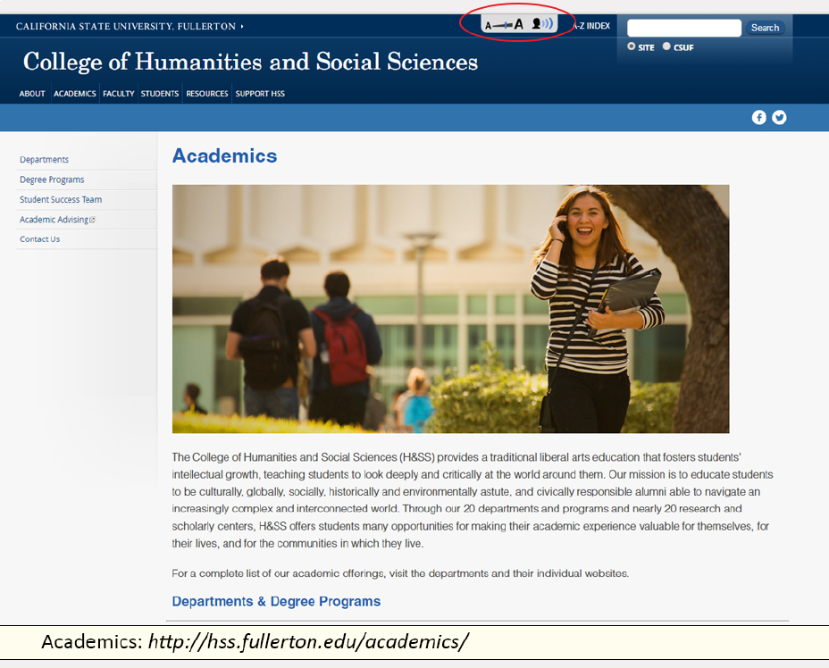
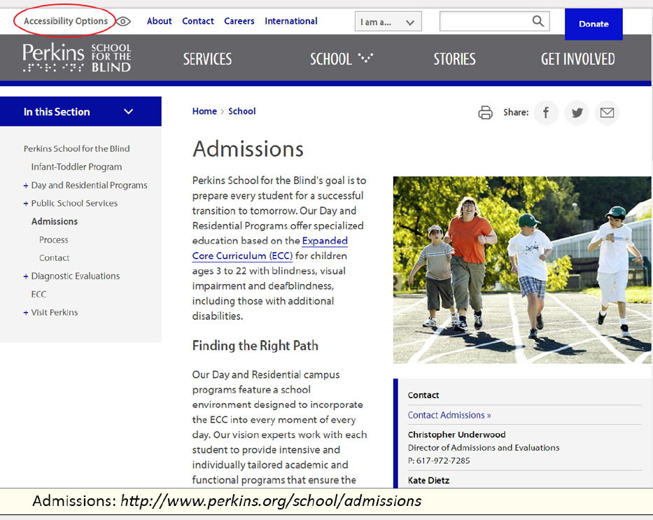
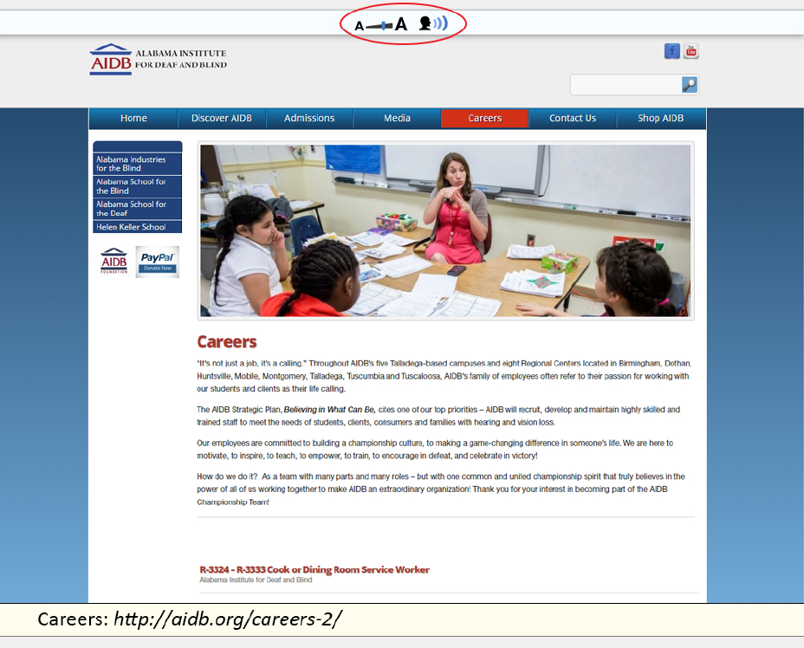
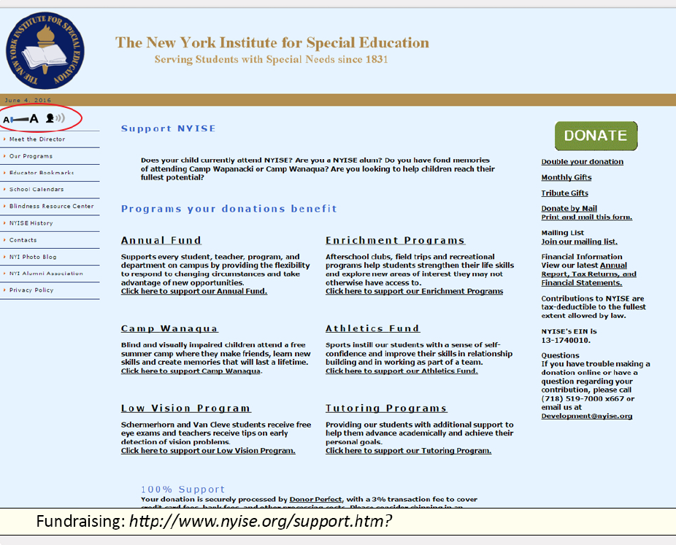
A single tool can improve accessibility across all areas of education
Academics
Admission
http://hss.fullerton.edu/academics
http://www.perkins.org/school/admissions
Careers
Fund-raising
http://aidb.org/careers-2
http://www.nyise.org support.htm?
www.sitecues.com

Slide 4
What is Sitecues?
Software-as-a-Service for organizations with web-based content
The same core technology has many applications
Build zoom, speech, color themes and other reading enhancements into any web content
Seamlessly integrates without a redesign
Users can customize their view without impacting others
Simple and easy to use
Websites
Web browsers
Learning Management Systems
Online databases and applications
www.sitecues.com

