Slide 1
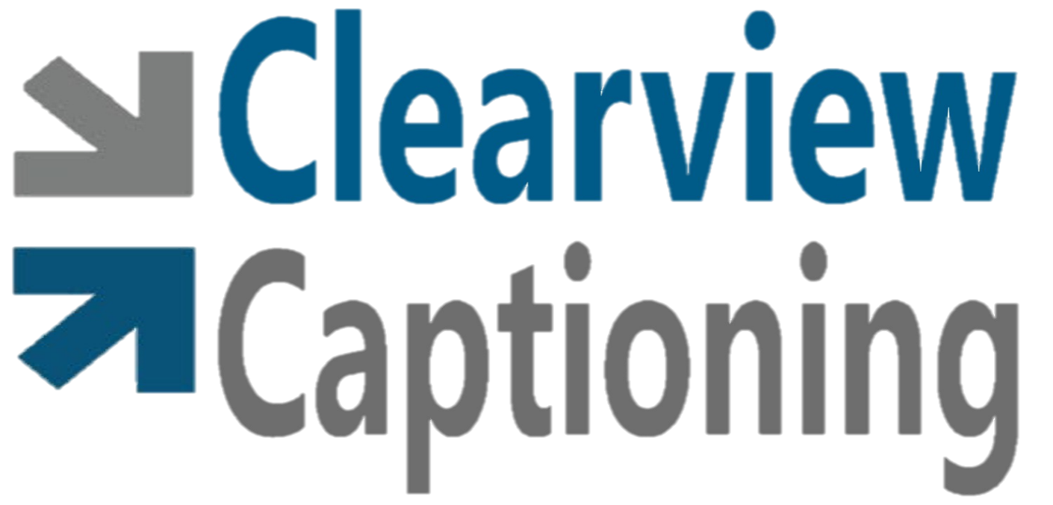
Providing Services for Deaf and Hard of Hearing
Notes:
One of the fastest growing technologies out there is communication access for Deaf and hard of hearing communities. Clearview Captioning was founded based on an ever increasing need for real time captioning services for these communities.

Slide 2
Company background
In operation for 4 ½ years
Combined 25 years of experience
Certified in Sign language Interpreting
Experience in a variety of settings
Michigan based, minority owned
Strict adherence to RID Code of Professional Conduct
Licensed and Insured

Slide 3
Services offered
C-Print
Available on site or Remote
CART
Available on site or Remote
Interpreting
Translation
Resources for Closed Captioned videos
Notes:
Voice to text services, such as Cprint offer a meaning for meaning to English text transcription that can be viewed from a laptop, tablet or even an I phone then downloaded to a jumpdrive for later review if wanted.

Slide 4
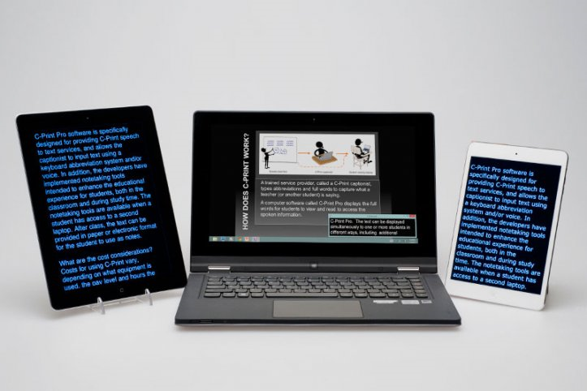
What is C-Print?
The System
C-Print is a speech-to-text (captioning) technology and service developed at the National Technical Institute for the Deaf, a college of Rochester Institute of Technology. The system successfully is being used to provide communication access to individuals who are deaf or hard of hearing in many programs around the country. In addition to educational environments, C-Print also can be used in business and community settings, and with individuals with other disabilities, such as those with a visual impairment or a learning disability.
The Service
The basis of C-Print is printed text of spoken English displayed in real time, which is a proven and appropriate means of acquiring information for some individuals who are deaf or hard of hearing. A trained operator, called a C-Print captionist, produces a text display of the spoken information in classroom or other settings. At the same time, one or more students read the display to access the information. A C-Print captionist includes as much information as possible, generally providing a meaning-for-meaning translation of the spoken English content. After class, the text can be provided in paper or electronic format for the student to use as notes.
The Technology
C-Print Pro software is specifically designed for providing C-Print speech-to-text services. It allows a captionist to input text using a keyboard abbreviation system. The abbreviation system is based on phonetics, or how words sound. Although spelling-based abbreviations might seem easier to learn, in practice, abbreviations based on how words sound are more instinctive because unlike traditional keyboard typing, a C-Print captionist processes information auditorily. Typing using abbreviations based on how words sound is an extension of the auditory process. In addition, problematic spelling is not an issue. The software also can accept input from automatic speech recognition applications.

Slide 5
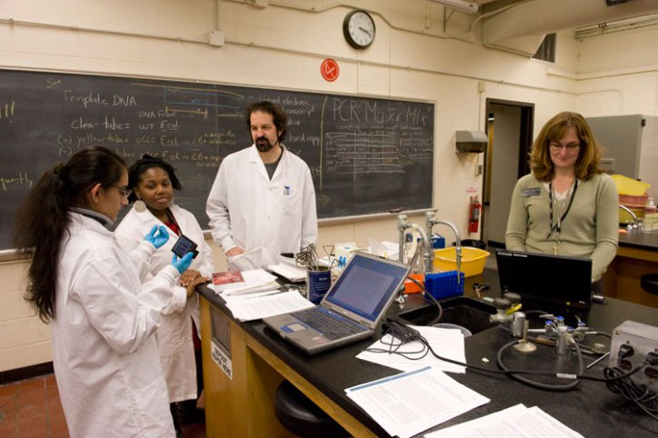
Onsite Service
C-Print Captionist in class with client

Slide 6
Questions?
Clearview Captioning provides remote, real time captioning in a variety of settings. We offer both CART and C-Print.
CART(Communication Access Realtime Translation) is a word for word transcription, while C-print is a more condensed form of live captioning, sometimes referred to as meaning-for-meaning translation.
Our goal in educational settings is always the success of the student, and therefore to match their need with the most beneficial type of captioning.

