Slide 1
www.vfo-group.com
Continuous zoom with 2x–24x magnification
Vibrant 7-inch screen
Built-in reading stand
HDMI port to connect to your TV
Lightweight design at 18 ounces
Unique PivotCam rotating camera

Slide 2
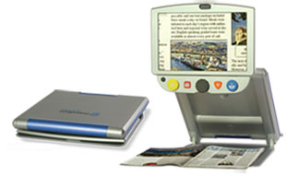
www.vfo-group.com
TOPAZ PHD
Lightweight, collapsible, portable design
Choice of monitor sizes: 12-inch or 15-inch
Auto-focus camera
Document reading and self-viewing modes
Over 9 inches of working space to write and work comfortably
Adjustable reference lines and masks to easily keep your place and reduce glare

Slide 3
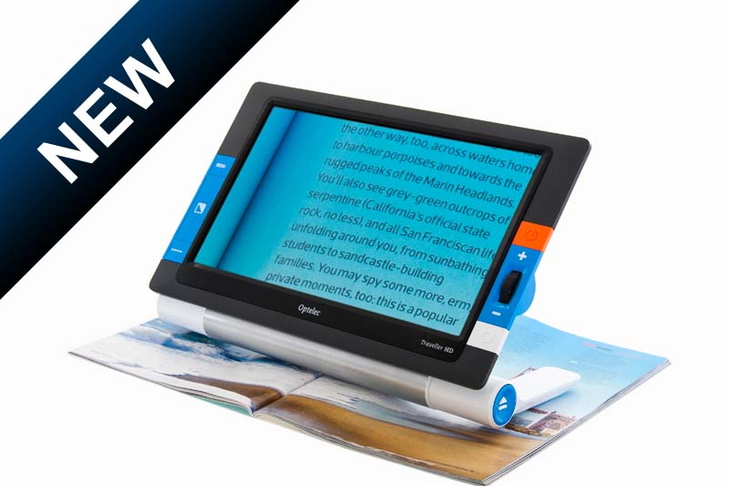
www.vfo-group.com
Traveller
Light weight
Unique Slide & Read mechanism
Ready to use when the screen is in reading position
Designed to move smoothly over reading materials
Full High Definition image quality

Slide 4
www.vfo-group.com
ClearView C with Speech
Continuous magnification: 1.5X – 75X (optional: up to 170X)
Superior High Definition 1080p video processing for ultra sharp and vivid images
Fast text recognition (OCR)
Over 60 reading voices in 30 languages
Headphone connector
Point & Read functionality: intuitive touch interface

