Slide 1
Disability and Intersectionality on College Campuses
A case for inclusivity through personal stories

Slide 2
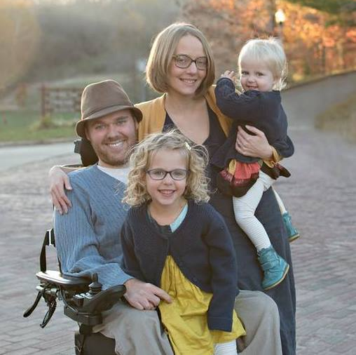
Who am I?
MSW, LSW, TICC, SSA,
Partner, Father, Counselor, Disability Rights Activist, Absurdist Think Tank Founder
Help people with disabilities have a community-based, good life
Founded FANs program in Athens County

Slide 3
Who was I?
Unsure and Quiet
Liked sports
Apolitical
Deist
Depressed
Wanted to be a novelist

Slide 4
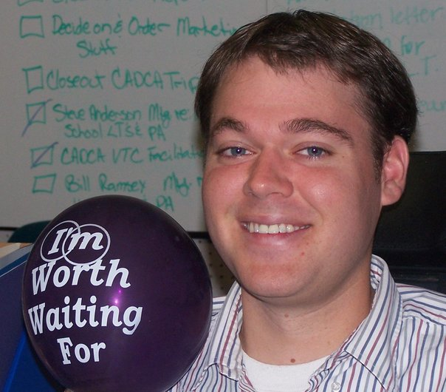
What happened?

Slide 5
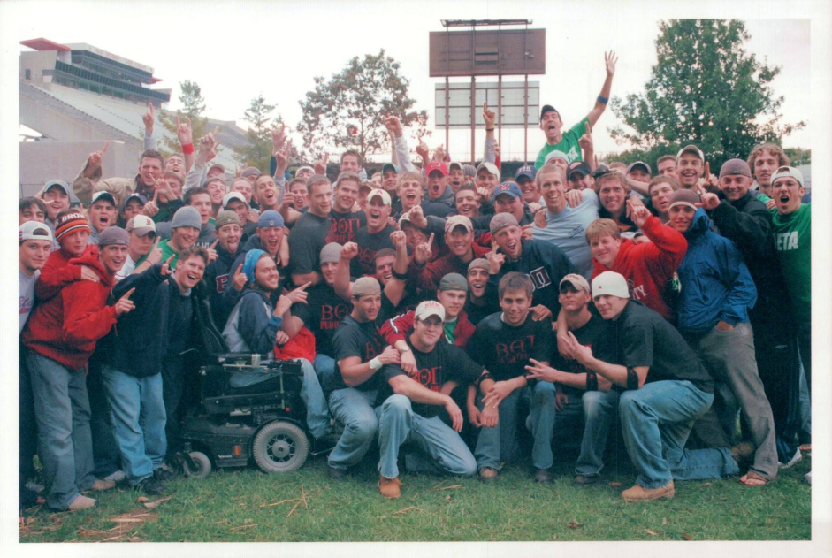
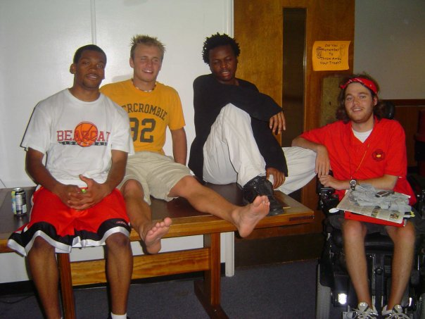
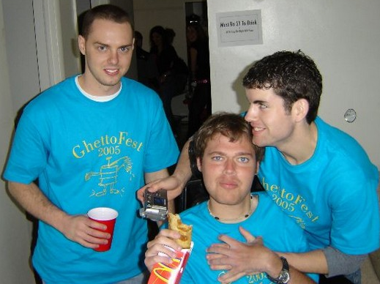
I went to College
Got Involved
President of Disability Awareness Club
But also
Joined Service Fraternity, Social Fraternity, BBBS, Crisis Hotline, Leadershape, Students for Peace and Justice, Urban Leadership Internship Program, English and Creative Writing major

Slide 6
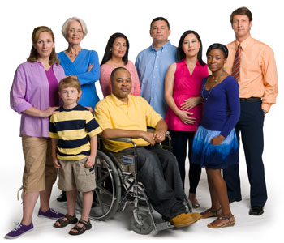
The Ideal College
Inclusive, Welcoming, Diverse, Challenging

Slide 7
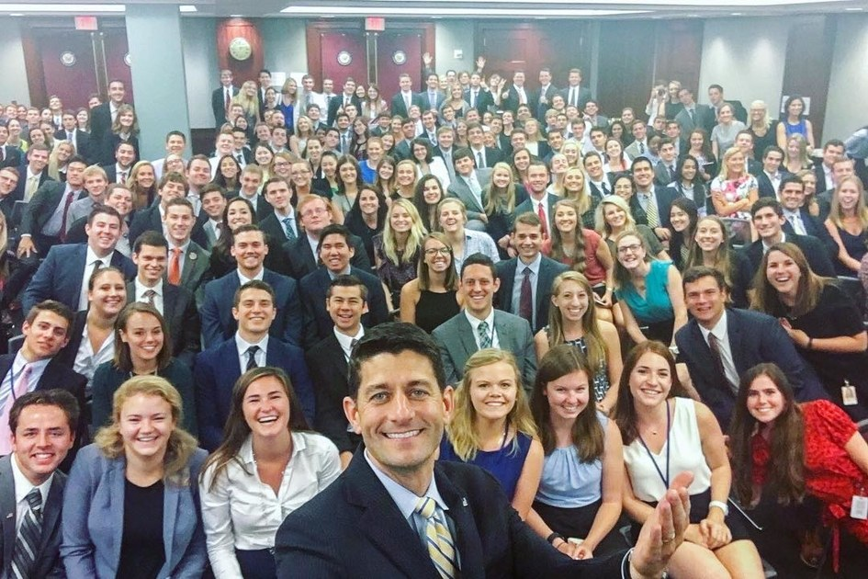
The Real College

Slide 8
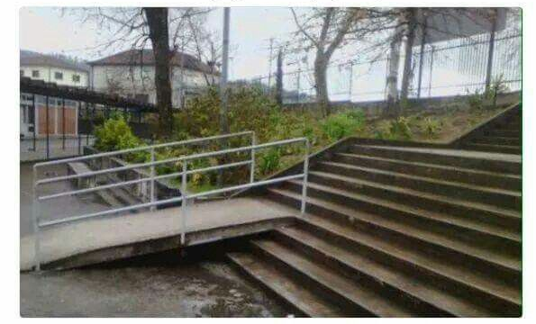
Real College The Step Single Incident

Slide 9
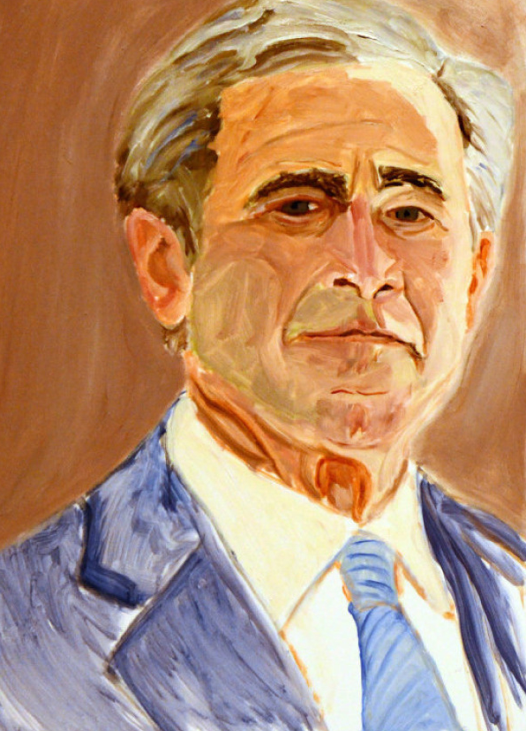
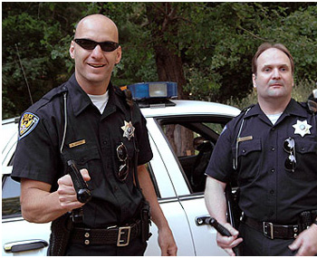
Times of Transcendence

Slide 10
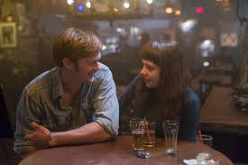
The Real World
I’m a teenage girl at a bar

Slide 11
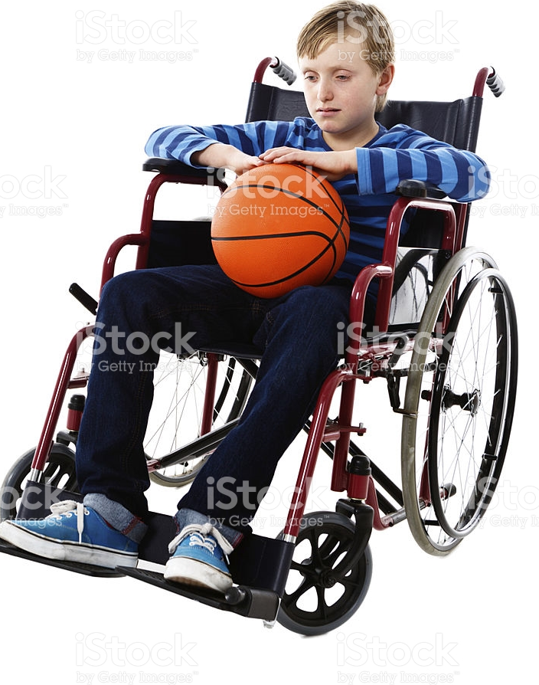
Inspiration Porn vs Pity Dichotomy

Slide 12
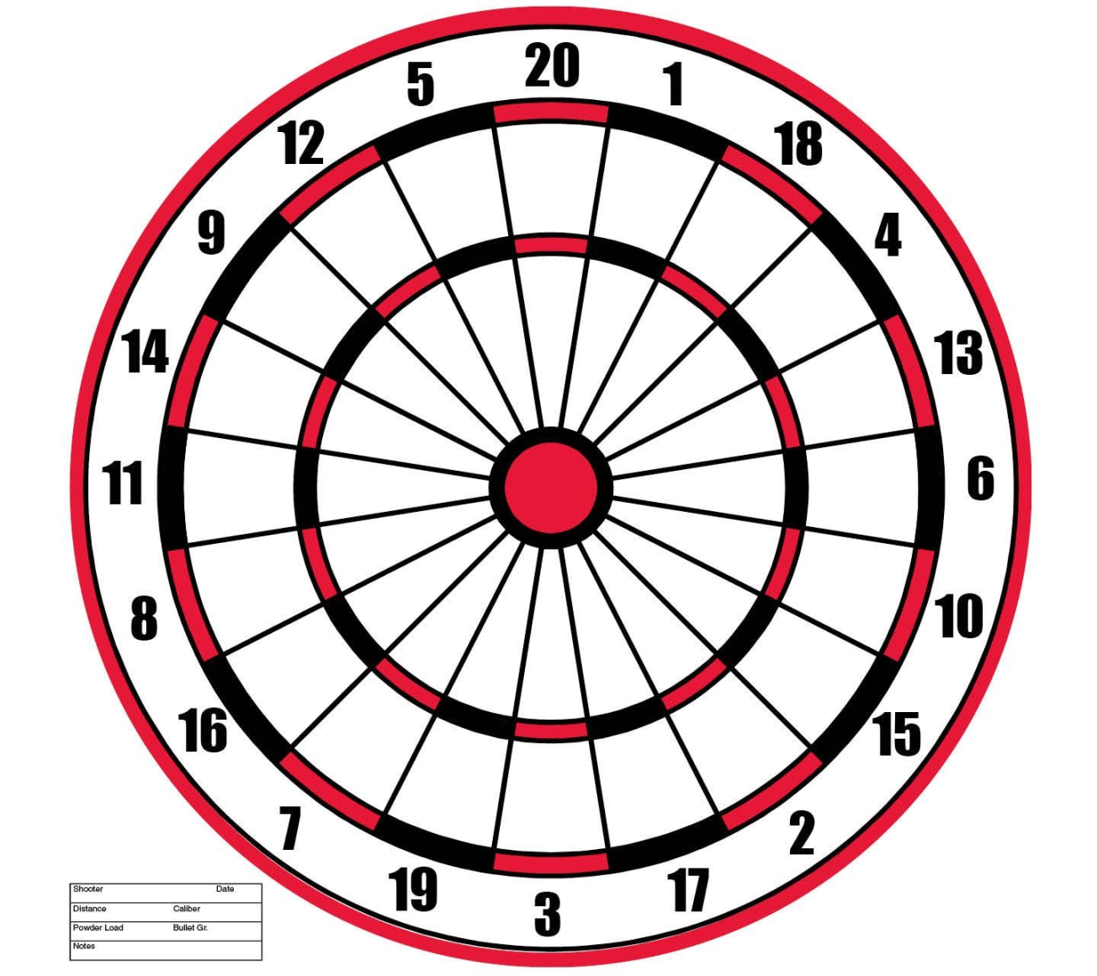
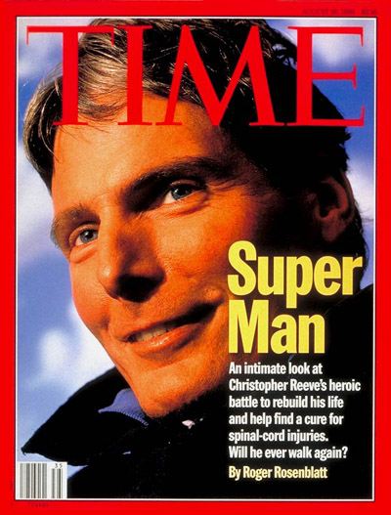
Why do negative stereotypes still exist? (Why I don’t like Christopher Reeve)

Slide 13
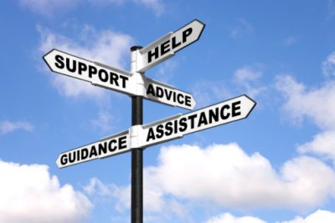
Advice Time Portion of Presentation
How do you make Disability part of the Intersectionality that is happening on campus?

Slide 14
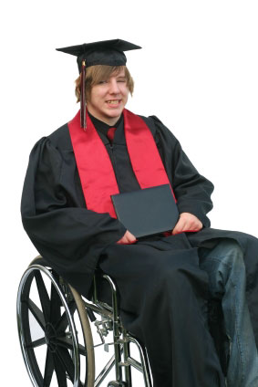
1. You have to have people with disabilities on campus

Slide 15
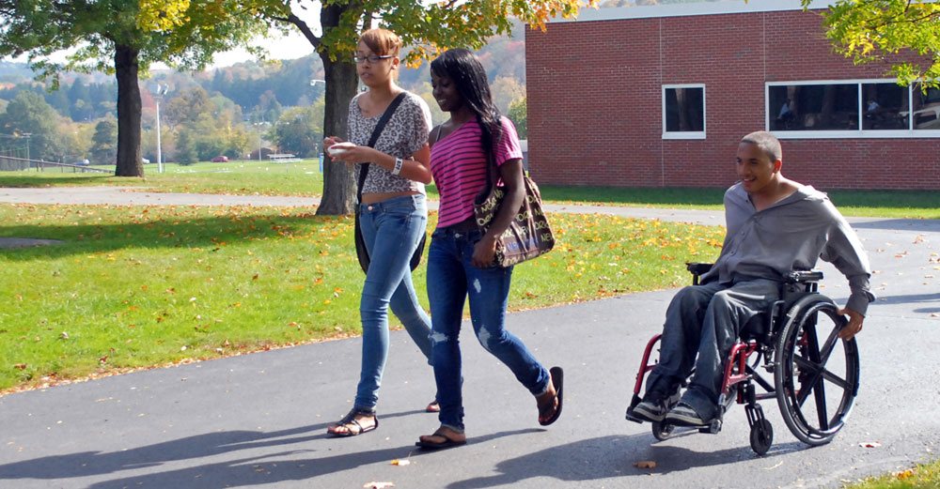
2. Normalize Disability on Campus

Slide 16
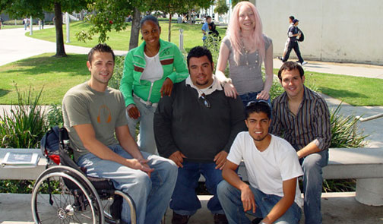
3. Create intentional space

Slide 17
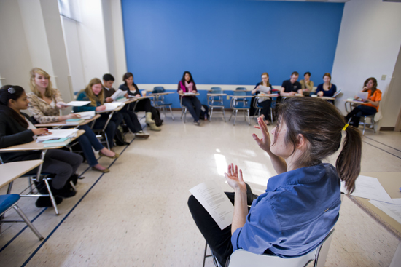
Find leaders and work with them

Slide 18
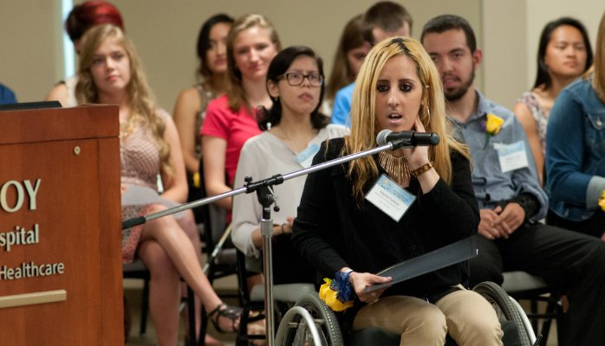
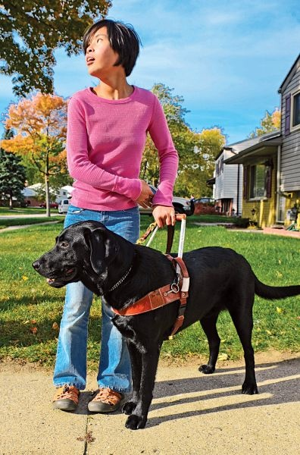
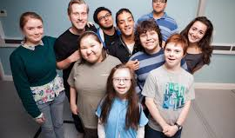
Look for innovation . Fight Inspiration Porn/Pity Dichotomy

Slide 19
Questions and Contact
David McNelly
davidmcnelly@gmail.com
740-222-2482

