Slide 1
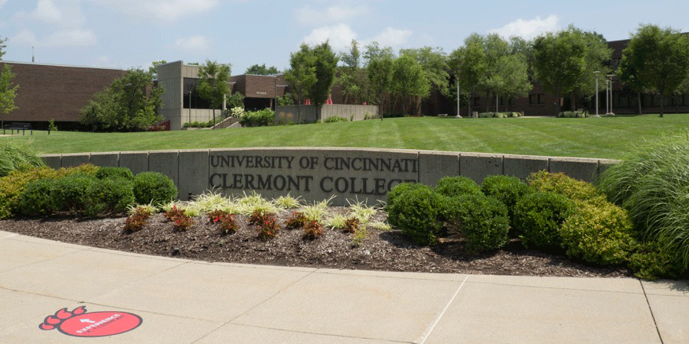
We’re Waiting for You! University of Cincinnati – Clermont College
AmyLou Simerly, MS Ed
Lesley Dorhout, MS

Slide 2
Problem Presented
“K-12 and postsecondary sectors must develop stronger partnerships to create pathways and to facilitate student success in college” (American Institutes for Research Study, 2013).
Most students voiced either a misunderstanding or lack of understanding regarding transitioning to higher education.

Slide 3
We Needed Information
Where do our students come from?
What are the demographics of area?
What are the teachers concerned about regarding their students’ transition?

Slide 4
We Designed a Process
Met with professionals within schools
Offered follow-ups
Presented at schools
Invited groups to visit campus

Slide 5
Accessibility Resources: The Process……
All students with disabilities meet the same admission standards as their non-disabled peers.
Self-identify as a student with a disability.
Your IEP or 504 Plan don’t carry forward to college.
Complete an application – short & focused on you!
Interview with Amy
Develop a plan suited to meet your needs

Slide 6
Accommodations…
Disability information is confidential
Require students to meet with professors to discuss their academic accommodations privately
Instructor letters rather than copies of an IEP
Use of Accommodations is a student driven decision:
Use all accommodations, one, two, or none
All classes or the class of your choice
Testing situations

Slide 7
What is a Successful Student?

Slide 8
What Interferes With Success?

Slide 9
What Are Your Next Steps?
Exercise your independence in an environment you are familiar with.
Discuss your IEP and disability with your Intervention Specialist
Role play conversations about self-identification and your accommodations
Spend 9 weeks requesting your accommodations
Practice personal responsibility
Discuss the rigor of college vs. high school with your teachers
Research technology to help you now and in the future

Slide 10
What did you learn today? or What questions do you still have?

Slide 11
What Did They Learn?
How long does it take to complete a degree program?
How many credits is in a degree?
Is there money available to help pay for my education?
What type of help is available for me on your campus?
How long is a school year?
How many students attend UC Clermont?
When do you tell someone about you’re your accommodation needs?
When do you apply?

Slide 12
References
Improving College and Career Readiness for Students with Disabilities; American Institutes for Research Study, March 2013.
Listening To Their Voices: Factors That Inhibit or Enhance Postsecondary Outcomes for Students’ With Disabilities; Dorothy F. Garrison-Wade, Journal of Special Education, Vol. 27, No: 2, 2012.
For Students With Disabilities, Transition From High School Requires Self-Advocacy; Sarah D Sparks, Education Week, Vol. 34, Issue 33, May 29, 2015.
Nine Strategies to Improve College Transition Planning for Students With Disabilities; Elizabeth C. Hamblet, Teaching Exceptional Children, Jan/Feb 2014.

Slide 13
Thank you for attending.
Amy Simerly
Program Coordinator
Accessibility Resources
513-732-5327
amy.simerly@uc.edu
Lesley Dorhout
Educational Advisor
College Success Program
513-732-5316
lesley.dorhout@uc.edu

