Slide 1
Three Branches of Student Success WVU Office of Accessibility Services
Teressa Oliverio-Frease MS, CRC
Holly Fox-Schauffner BA

Slide 2
Our goal:
The Office of Accessibility Services (OAS) is dedicated to enhancing the educational opportunities for students with temporary or permanent disabilities on all West Virginia University (WVU) campuses. To ensure access to University programs, specialists work individually with students, faculty, staff, and administration to assist in the implementation of accommodations that lead to academic and personal achievement.

Slide 3
Three Branches of Student Success
Advocacy-OAS utilizes a customer service approach to promote student-instructor inclusion.
Collaboration-OAS collaboratively works with other departments to assist in accommodating the student.
Innovation-OAS places high importance on the innovation and adaptation of current and appropriate student services.

Slide 4
Self-Advocacy
“Rite of Passage”
Independent decision-making and the ability to express one’s needs are two critical parts of self-advocacy
Notes:
The need for self advocacy is essential. Rite of passage allows individuals with disabilities to prepare for independence while becoming an adult.

Slide 5
Myth #1
Avoid labeling the student with a diagnosis because it can be damaging to their self-esteem….
Notes:
While labeling a student has its downfalls, not letting the student be aware of their diagnosis is just as harming. Give Example… By knowing they have a diagnosis allows them to self-advocate to the Accessibility Offices and Vocational Rehabilitation programs to get the support they need.

Slide 6
Suggested Practices
Teach the student how to describe their disability, strengths, weaknesses, etc.
Accept the diagnosis, and use it to determine your learning needs. Do not let it determine your identity.
Sample accommodations.

Slide 7
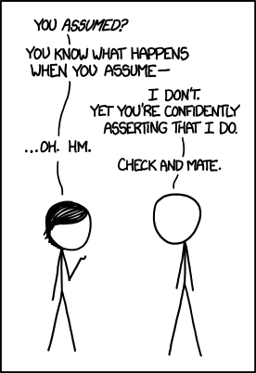
Myth #2
Just because the student has accommodations at a post-secondary level guarantees their needs will be met…..

Slide 8
Suggested Practices
Take responsibility.
Practice becoming more assertive.
Get to know the instructors in the program.

Slide 9
Myth #3
Obtaining the highest grades possible is the best way to measure self-advocacy….
Notes:
While higher grades may lead to more options educationally, this is not the only factor that comes into play. Higher grades do not show the student has learned self-advocacy. Students with learning disabilities spending all their time focusing on grades, may feel isolated due to all the work they put in to get the grades. Social skills are also required to lead a healthy life.

Slide 10
Suggested Practices
Enjoy relaxing and growth oriented activities. (rec center)
Seek a balance academically and socially.
Get involved in an activity on campus.
Seek a professionals help for personal difficulties. (Carruth Center)

Slide 11
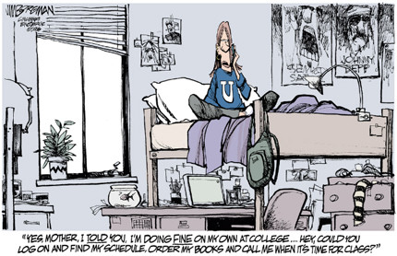
Myth #4
When students encounter a difficult situation, it is best for their parents to take over…
Notes:
This could not be farther from the truth! It is the student’s responsibility to learn how to advocate their needs. College is about problem solving, and learning how the real world works. If the student needs assistance they can always ask their accessibility specialist or advisors on where to start. Too many parents pick their son/daughters major, and then speak up about how they should be taught. Excessive parental involvement can cause resentment amongst faculty and staff, especially if they do not work directing with students with disabilities.

Slide 12
Suggested Practices
WVU Parents Club.
Parents need to let go, let them know gently.
The most valuable lesson a student can learn as they enter adulthood is about consequences.
Students need to learn to ask for help from those that can provide it in the post-secondary setting.
Notes:
After slide: students should be encouraged to take part in as many opportunities demonstrating their independence as possible. Parents, faculty, staff and the student win when the student learns to communicate their needs.

Slide 13
“I am not being accommodated” OAS Asks students:
Have you spoken with your Faculty member about your accommodations and how they will be implemented?

Slide 14
Forms

Slide 15
COLLABORATION
Notes:
The action of working with someone to produce or create something…

Slide 16
HIPPA VS FERPA
FERPA, the Family Educational Rights and Privacy Act, applies to most school health records most of the time.
HIPAA, the Health Information Portability and Accountability Act, applies to some school health records some of the time.

Slide 17
HIPPA VS FERPA
FERPA (Educational Records)
HIPPA (Protected Health Information PHI)
Any physical or mental health record of an individual.
Excluded from educational records and treatment records in FERPA
Records maintained by the university directly related to a student.
May include: academic, health information, accommodation requests…
Does not require consent for: school officials with legitimate educational interest, parents, health and safety…

Slide 18
Interactive Process: We are all under FERPA

Slide 19
Faculty and Staff Can:
Ask students who you see are struggling academically?
What do you think would help you here at WVU?
Have you ever gotten assistance in classes before?
Did you have an IEP or 504 plan in high school?
Did you ever attend a class that was more like tutoring then teaching you subject matter?
If “YES” to any of the above please urge them to come speak to us to see if we may be of assistance

Slide 20
When Speaking with a Student:
Be direct
At times you may need to describe all steps even ones you find to be intuitive
Break information into small chunks
Give students processing time
Have students repeat information or put it into their own words
Follow up with an email with the information or steps the students has to complete
Don’t be afraid to ask for an Accessibility Specialist to team an advising session

Slide 21
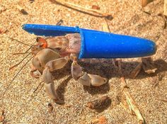
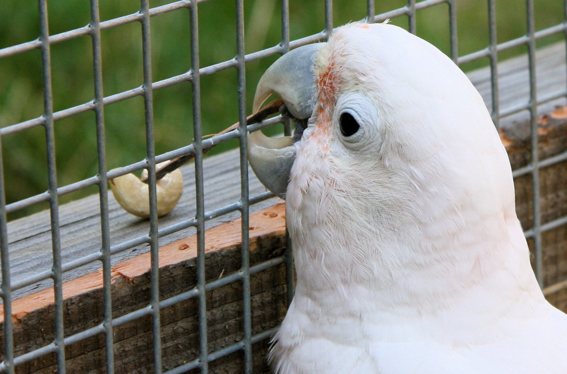
Innovation
Notes:
SWITCH GEARS –
As students rely more on technology in education, it is necessary to adapt to facilitate changing student needs.
Student accommodations must adapt to changes in technology by providing innovative ways for students to have a more active role in their educational success.

Slide 22
Notes:
Remote TW is one service that bridges the gap between technology and student success.
Explain TW process

Slide 23
Notes:
TypeWell is conducive to classroom settings and one on one meetings where other software isn’t a great fit since the information is presented in a more concise, direct way
Students receive a concise, user-friendly transcript
High readability
White space
Bolded key terms
Discuss transition from on-site to remote

Slide 24
Preparing for class
Collaborate with instructors
Vocabulary and terminology
Class conventions
Material for captioning
Notes:
Part of an effecitive remote TW process:
requires an ongoing dialog with instructors to ensure that accurate information is captured for students during the transcription process.
collaboration with instructions is key to service provision because…
List reasons.

Slide 25
Working with instructors
How not to work with instructors
Notes:
Part of the discussion about accommodations results in greater understanding by faculty and clarifies misconceptions and generates a productive dialogue of collaboration to facilitate student success
Don’t be this guy.
Show video.

Slide 26
Captioning
Notes:
Another way to collaborate with instructors to promote student success and advocacy is through the provision of closed captioning.
Why?
80% of people who used CC are not DHOH
ESL
Facilitate comprehension of dialogue spoken quickly, accents, mumbling, or background noise
Full names, brand names, or technically terminology provide clarity for readers
Help maintain concentration.
can provide better experience for readers with learning disabilities, attention deficits, autism.
Helps comprehension in noisy environments
Improve engagement, retention, and overall learning experience for all students, not just those requiring accessible content

Slide 27
Closed Caption
YouTube Caption Fail
Notes:
For these reasons, proper captioning is important.
Don’t rely on YouTube.
Show video.

Slide 28
Benefits of speech-to-text services
Promotes self-advocacy
Facilitates collaboration
Creates more readily attainable access to communication
Promotes autonomy
Participation
Removes barriers
Notes:
* With immediate access to communication, students can participate more easily
Promotes self-advocacy - Students have conversations with instructors, which generates further discussion about their accommodations
Facilitates collaboration - Oas communicates with instructors about the students’ needs, which establishes advocacy and communication on behalf of the student
Creates more readily attainable access to communication - Students may receive STT services more easily when providers aren’t required to be present, so we can be literally anywhere that the student needs us to be
Promotes autonomy - Students may choose to self-identify to their peers if they utilize accommodations since no obvious accommodations are visible to others
Participation - Students may more easily integrate into all aspects of their education as a result of having real-time access via TypeWell technology
In general, this is a service that assists in removing barriers for students as a result of effective collaboration, advocacy, and innovation in education.

Slide 29
Sources
Goldhammer, R., & Brinkerhoff, L. C. (n.d.). Self-Advocacy for College Students. Retrieved October 10,
2018, from http://www.ldonline.org/article/6142
Intellitext. Choosing Between TypeWell and Cart Services. Retrieved from
http://intellitext.us/uncategorized/choosing-between-typewell-and-cart-services.html
Kelly, L. (2010, Dec 15). A Few Minutes in the Life of a Sign Language Interpreter, The Classroom.
[Video file]. Retrieved from https://www.youtube.com/watch?v=1cqv84ywBSE
Reilly, J., et al. (Producers and Directors), & (2010). Check It Out! [Television series]. USA: Adult Swim.
Rhett & Link. (2012, May 10). CAPTION FAIL: Mr. Cuddles. [Video file]. Retrieved from https://www.youtube.com/watch?v=7lTUXVfTVOg
Strada Communications, Inc. (2015, March5). What is TypeWell Transcription? [Video file]. Retrieved
from https://www.youtube.com/watch?v=bN0-6C1S3fU

