Slide 1
Top 10 Things Disability Resource Professionals Should Know (but never learn in school)
Adam Crawford
The Ohio State University
Amanda Feaster
Kent State University

Slide 2
Introductions & Agenda
Introductions:
Adam
Amanda
A few caveats about this list:
Items are in no particular order.
These are lessons we (or close colleagues) learned through years of working in disability resources.
Your mileage may vary.

Slide 3
#1. Don’t stop interacting!
INTERACTIN'
"Hold on to that PRO-CE-E-E-ESS!"
The interactive process is your best friend. Use it even when it annoys you, like an older sibling that has to be right all the time.
If you haven't interacted with the student and the instructor, you're not done.
OCR will always check for interaction
Notes:
Example:

Slide 4
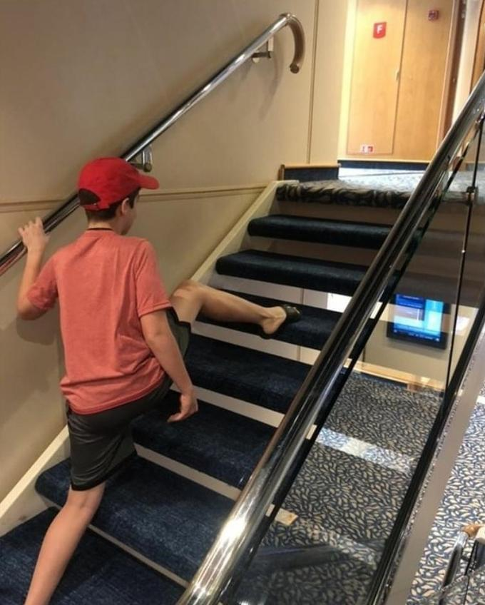
#2: Build a good process and follow it.
Likely outcome
Don't skip steps, even if you think you know what the outcome will be.
Fundamental alteration determination (Wynne v. Tufts)
There is no matrix of X disability = Y accommodation.
Well-meaning DRP
Consultation
Reviewing 3rd party doc
Talking to students
Notes:
Example: Kent State fashion OCR complaint, don't use equations for determinng accommodations

Slide 5
#3. Never Say Never
Nothing is off the table until you've gone through your processes.
"We're an in-person institution" … until we hit a global pandemic and realize what we can do virtually.
Notes:
Example: COVID

Slide 6
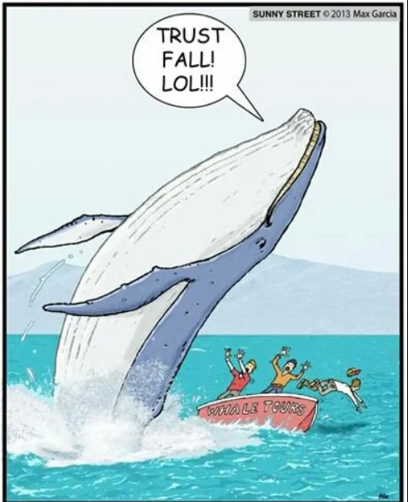
#4: Trust the Process
The process IS the right answer, even if the outcome isn't perfect.
Students can and should use the grievance process.
Did you:
Follow the process?
Gather all information?
Act in good faith?
Do your best?
Notes:
Example: Adam

Slide 7
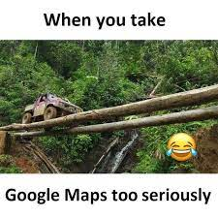
#5: Laws are landmarks, not maps
Use legal cases, OCR resolutions, etc. with a grain of salt.
All cases have specific details that may or may not be public.
Circumstances change all the time; courts can take years to catch up.
Notes:
Example: University of Akron’s note-taking process

Slide 8
#6: Ask for help!
You’re not alone (even if you are the only DRP on your campus)!
Make general counsel your BFF
Use Ohio AHEAD, national AHEAD, and other connections to bounce ideas off someone else
Notes:
Example: ADM revisions for literally everyone

Slide 9
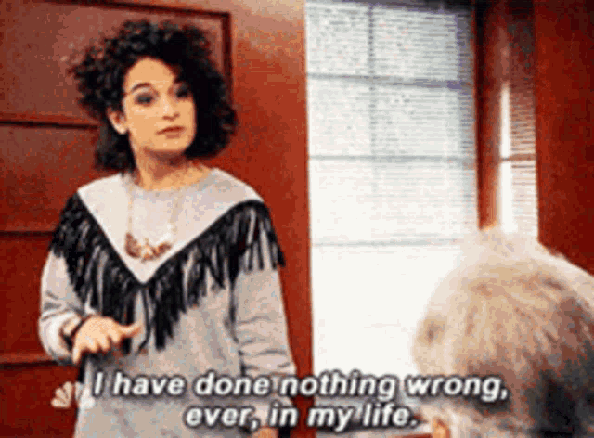
#7: Find the actual barrier.
"That" Student
Sometimes students face challenges that aren't environmental barriers.
Define the actual barrier to properly accommodate students.
Internal (procrastination, avoidance, etc.)
External (time, physical, format)
Notes:
Example: ADMs

Slide 10
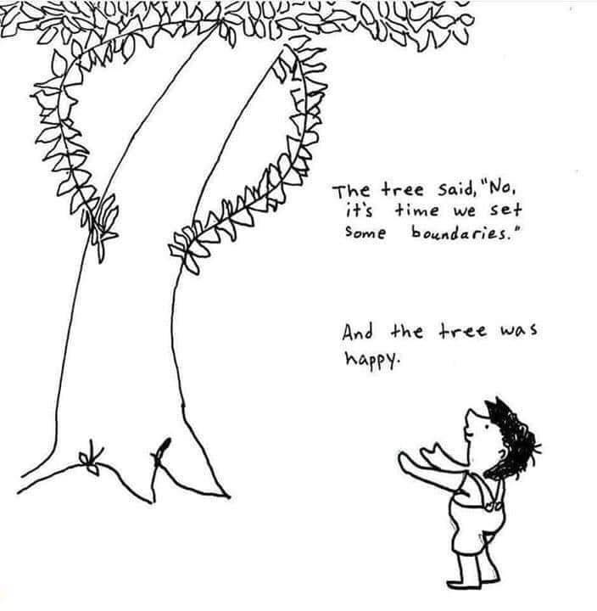
#8: Good boundaries make good DRPs.
Don’t let “emergencies” take over your work.
Students can be held responsible for meeting reasonable standards.
Protect your own peace
Notes:
emotional work, similar identities to students makes work even more personal

Slide 11
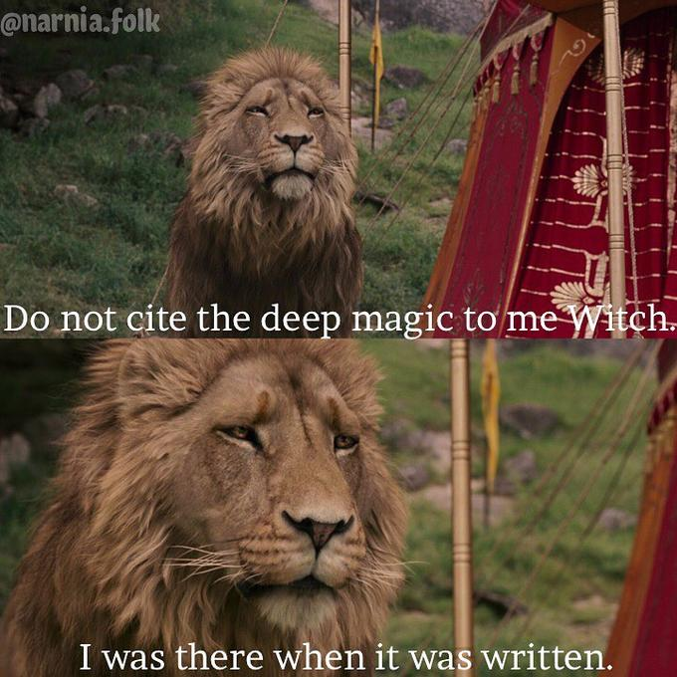
#9: Own your expertise
When an ignorant faculty member or administrator tries to tell you how the ADA works
Educate your boss so you have backup.
You/your office may be the only ones who actually know how this works
Numbers don’t mean the same thing to outside people.
Learn to tell your story in a meaningful way.
Notes:
Example: #s of accommodations are meaningless if others don't know how long each one takes to implement; you may have to educate your boss/their boss/their boss's boss's boss.

Slide 12
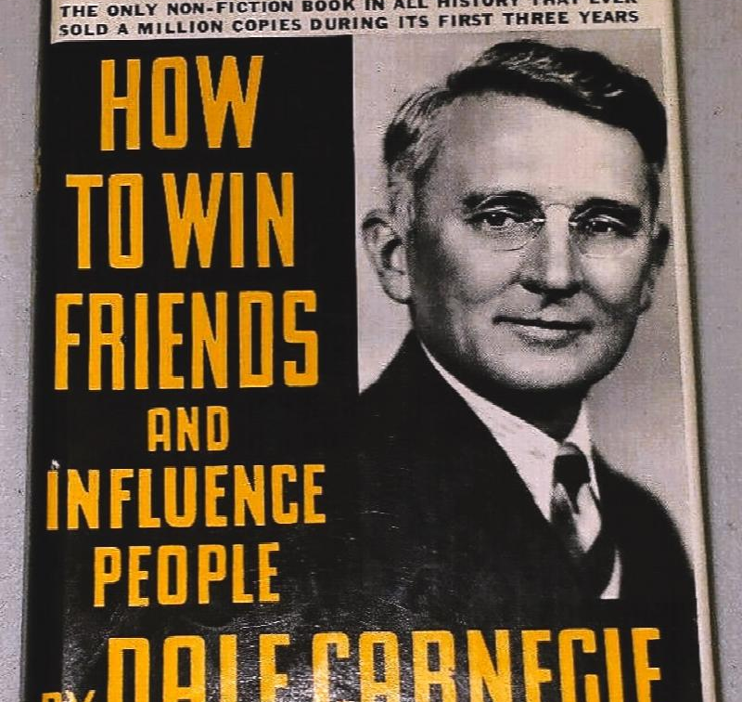
#10: Build bridges, don't burn them
Accessibility doesn’t happen in a vacuum.
Find allies and build relationships.
Legal language and lingo aren't always welcoming or persuasive.
Add choice to the conversation where you can.
"We all have the same goal."
Notes:
the power of choice
Transparency/clarity
Legalistic language often isn’t persuasive/welcoming/easily understandable.

Slide 13
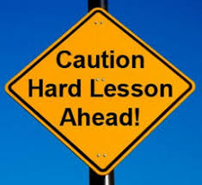
Q&A or Discussion
What lessons did you learn the hard way?
What do you wish someone had told you at the beginning of your DRP career?

