Slide 1
From Principles to Practice: Finding the “Reasonable” in Accommodations
Presented by L. Scott Lissner
ADA Coordinator & 504 Compliance Officer
The Ohio State University
10/14/2022

Slide 2
Reasonableness Who is this “Reasonable Person”?

Slide 3
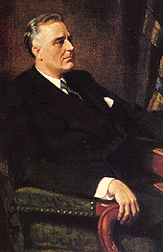
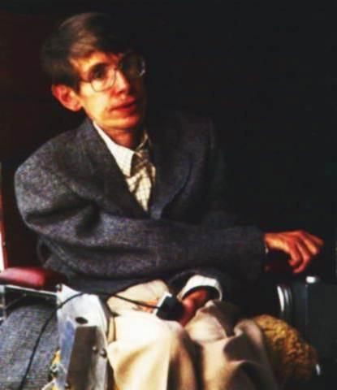
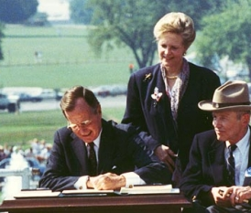
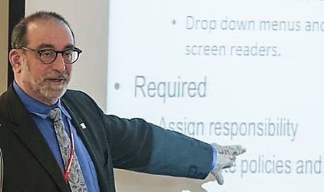
WHY PROVIDE ACCESS?
It is the right thing to do
Diversity maximizes talent & innovation
It’s the law
Institutional policy that reflects our mission & guides our practice

Slide 4
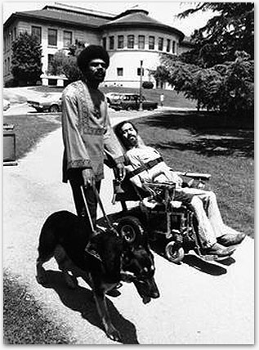
The Societal Goal of the ADA & 504
Full participation in social, political and economic activities by:
Ending the segregation and isolation of persons with disabilities
Securing equal opportunities
Ensuring equitable treatment
Fostering independence
Notes:
Image: Black and white photo circa 1973 In the foreground is a German Shepherd in harness guiding a man who is black wearing a dashiki (Dan Galway); to his left is a bearded man, white, in a wheelchair, a strap around his upper arms and chest holds him up in the chair (Ed Roberts)

Slide 5
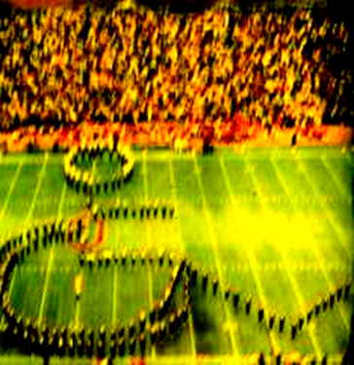
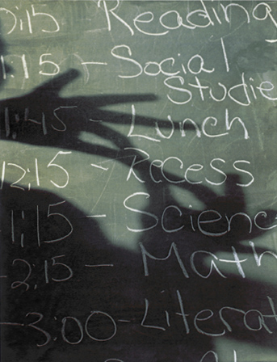
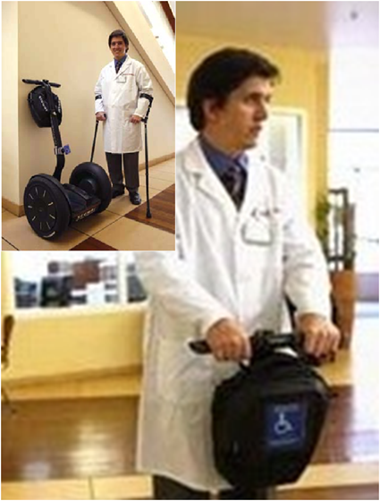
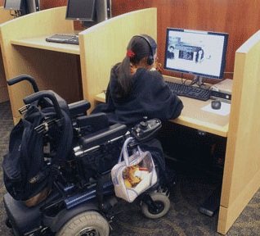
The Mandate to Higher Education
Provide effective access to programs, benefits and services for qualified individuals with disabilities with substantially equivalent ease of use and in the most integrated manner possible.
Section 504 of the Rehabilitation Act 34 CFR 104
Title II of the Americans With Disabilities Act 28 CFR 35

Slide 6
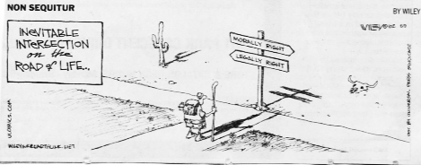
Just because you can - Doesn’t mean you should.
Just because you should - Doesn’t mean you have to.
Just because you have to - Doesn’t mean it is right.

Slide 7
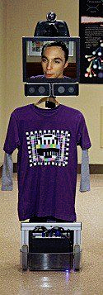
What Is An Accommodation?
A modification to policy, procedure, practice, or the environment
the provision of a tool, technology, or service
that partially mitigates the impact of a disability allowing an individual to participate.

Slide 8
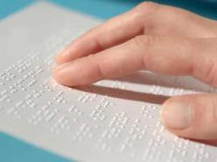
Determining Possible Accommodations Condition Manner Duration
Endurance and length of time required allotted to perform the activity
tools needed to perform the activity
Changes in the environment that allow the individual to engage in the activity
Is there a different path to the same essential goal?
Notes:
Condition illustrated by close up shot of classroom desk tops showing hands filling in scantron answer sheets; Manner illustrated by a hand reading Braille; Duration illustrated by a hand holding a stop watch

Slide 9
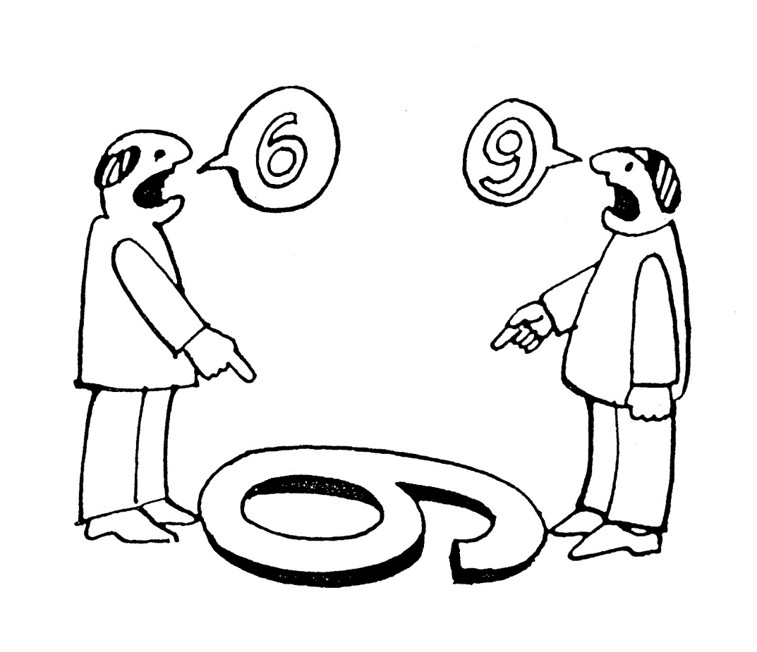
When Are Accommodations Reasonable?
Addresses an impact of the disability
Manner, Condition & Duration not outcome
Does not create a “Direct Threat” to others
Likely, imminent, significant & can not be substantially reduced with accommodations
Does not create an undue burden
Financial
Administrative
Does not create a fundamental alteration
Comparable experience, performance or evaluation

Slide 10
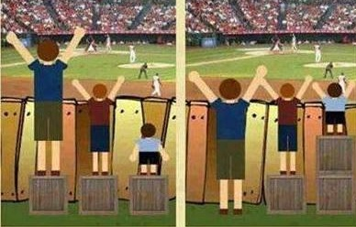
“Congress understood in shaping the ADA that including individuals with disabilities among people who count in
composing 'We the People,' would sometimes require not blindfolded equality, but responsiveness to difference; not indifference, but accommodation.” Ruth Bader Ginsburg, Tennessee v. Lane
Notes:
Image: Two images side by side. The first shows a baseball game in the background and a solid wooden fence in the middle ground. I front of the fence are three boys of different ages each standing on a wooden crate so that the fence comes up to the waist of the first and tallest boy; to the chin of the second; the final boy’s head is well below the fence and cannot see the baseball game. The second image shows the same baseball game in the background and a solid wooden fence in the middle ground. The same three boys are in front of the fence. The first and tallest boy is standing on the ground so that the fence comes up to his chin; the second is standing on one crate so that the fence comes up to his chin; and the final boy is standing on two crates so that the fence comes up to his chin.

Slide 11
Fundamental Alteration
The “fundamental or core goals” of the course or program
Licensing requirements
Academic and technical standards
The purpose and outcome, rather than the format of delivery or evaluation
Central knowledge, skills, or experiences
Congruently applied

Slide 12
Evidence for Fundamental Goals
Course descriptions, syllabi and tests
Certification, accreditation & licensure requirements
Consistency across sections, times, instructors
Congruent with program/degree goals
Referenced in curriculum creation documents
No history of exceptions

Slide 13
Process, Process, Process
An individualized interactive process must be used to determine if reasonable accommodations would allow a student to meet essential standards
28 C.F.R 35.104
Wynne V. Tufts University School of Medicine, 932 F.2d 19
School Board of Nassau County v. Arline, 480 U.S. 273
Southeastern Community College v. Davis, 442 U.S. 397

Slide 14
There is no indication of who took part in the decision or when it was made. Were the simple conclusory averment of the head of an institution to suffice, there would be no way of ascertaining whether the institution had made a professional effort to evaluate possible ways of accommodating a handicapped student or had simply embraced what was most convenient for faculty and administration. We say this, of course, without any intent to impugn the present affiant, but only to attempt to underscore the need for a procedure that can permit the necessary minimum judicial review. Wynne v. Tufts University School of Medicine 932 F.2d 19 (1991)

Slide 15
Determinations must be made by a group that includes individuals who are knowledgeable in the discipline/area, the available alternatives for instructional delivery and evaluation and disability
University of Houston, OCR# 06-02-2029
Guckenberger v. Boston University, 657 F. Supp. 106
Wynne V. Tufts University School of Medicine, 932 F.2d 19
School Board of Nassau County v. Arline, 480 U.S. 273

Slide 16
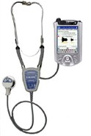
“It is possible to envision situations where an insistence on continuing past requirements and practices might arbitrarily deprive genuinely qualified handicapped persons of the opportunity to participate in a covered program.” (Southeastern Community College v. Davis, 442 U.S. 397)
Notes:
Image: Photograph of a stethoscope attached to a smart phone

Slide 17
Scenarios
Remote Participation
Attendance
Extensions
Student Conduct
Internships and Field placements
Assistance Animals
What is in your baggage?

Slide 18
CONTACT
L. Scott Lissner,
ADA Coordinator, The Ohio State University
Lissner.2@OSU.EDU Http://ada.osu.edu
(614) 292-6207(v); (614) 688-8605(tty)
(614) 688-3665(fax)

Slide 19
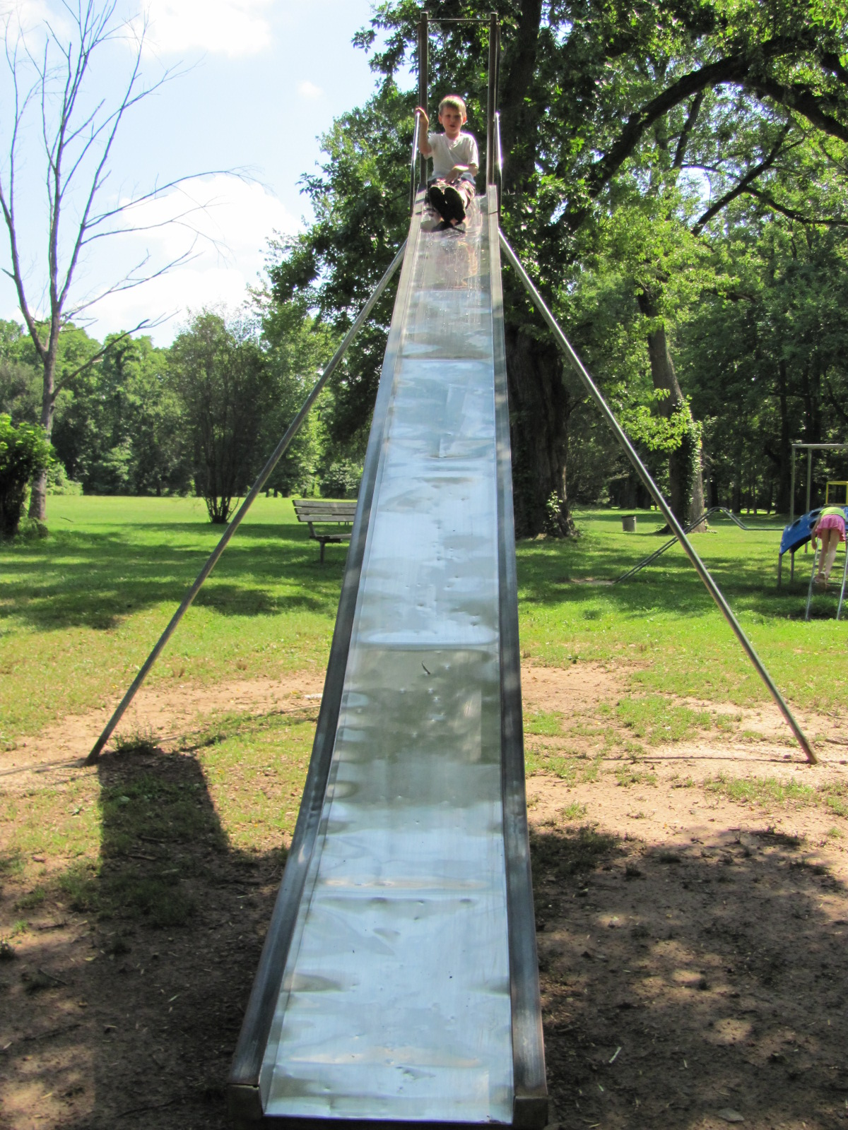
BONUS SLIDES

Slide 20
Documenting Accommodations
MANNER __ CONDITIONS DURATION
BARRIERS FACILITATORS
BARRIERS FACILITATORS
BARRIERS FACILITATORS
Individual
Experience
Impairment
Context
Micro
Task/Evaluation
Course
Mezzo
Program
College
Macro
Institution/system
State & Federal

Slide 21
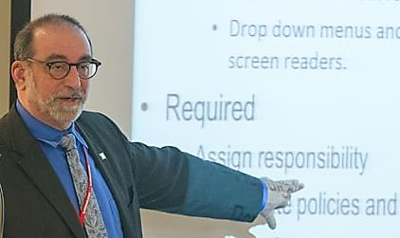
Access Infrastructure Administrative Requirements
Non-Discrimination
Notice
Web
Student Handbooks
Syllabi
Designee
ADA Coordinator & 504 Compliance Officer
Accessibility
Built Environment
Digital Environment
Communications
Programs/Services
Accommodation
Curriculum
Evaluations
Practica
Employment
Events
Grievance
AUTHORITY

Slide 22
Academic Standards & Deference
Academic institutions, making academic decisions, within their areas of expertise, will receive substantial deference from the courts. (Michigan v. Ewing)
Mere reliance upon tradition or existing rules may well not be a sufficient justification for refusing to implement a requested accommodation (Southeastern v. Davis; PGA v. Martin)

Slide 23
Academic Standards & Deference
Deference is earned through adherence to a “diligent” consideration of the request and “alternative means” to achieving the fundamental program objective, resulting in a “rationally justifiable conclusion
Wynne v. Tufts, Guckenberger v. Boston University

Slide 24
Technical Standards
Nonacademic criteria for:
Admission
Program participation
May apply at all times or just at one stage
Examples
Physical abilities in context: Ability to shift a patient in bed, ability to drive, ability to manipulate a particular medical instrument
Behaviors in the present: compliance with a code of conduct
Safety: does represent a “direct threat to health and safety” to self and others
Receive less deference

Slide 25
It is important that technical standards and eligibility criteria be established through a collaborative process. Both policy & practice must support that a standard is essential
University of Houston, OCR# 06-02-2029
Guckenberger v. Boston University, 657 F. Supp. 106
Wynne V. Tufts; University School of Medicine, 932 F.2d 19)

Slide 26
Both policy & practice must support that a standard is essential
Checks on the qualified status of students must focus on necessary information
34 C.F.R. 104.4 & 104.42
Colman v. Zatechka, 842 F. Supp. 1360
Briggs v. Walker, 88 F. Supp.2d 1196
Guckenberger v. Boston University, 657 F. Supp. 106
Wynne V. Tufts University School of Medicine, 932 F.2d 19
Wong v. Regents of the University of California, 192 F. 3d 807

Slide 27
Elements of Legitimate Standards
Establishes a skill or ability rather than a medical condition
Relate directly to:
essential (core) aspects of the program
academic or programmatic success
to skills necessary to obtain licensure (in licensure programs)
the safe performance of the skills the program seeks to develop

